Slide 1



Department of Computer Science MKBU University
TOUR MANAGEMENT SYSTEM
Presented By
Sagathiya Jaydeep
Pavasiya Parth
Under The Guidence Of
Mr Vishal Gauswami

Slide 2
Project Profile
Team Size | 1
Group no. | 15
Group Member | 2
Name Of Group Member | Sagathiya Jaydeep Pavasiya Parth
Project Title | Tour Management System
Project Definition | A Tour Management System Is various aspect of managing Tour and travel- related activities. It serves as a comprehensive tool to assist Tour Operator, Travel Operator and organizers in planning organizing and executing tours efficiently.
Back end tools | PHP, MySQL
Guide | Mr. Vishal Gauswami

Slide 3

Project
Tour Management System

Slide 4
CHAPTER-1
1. Introduction
1.1) Background of project
1.2) Objective of project
1.3) Scope of project
1.4) Applicability

Slide 5
INTRODUCTION
The sub of the phenomena and relationship arising from tour
and stay non residents.
Tour management system provide reservation facility to there
customer.
Maximize tour policy compliance all area including best fares
allowances and approval.

Slide 6
1.1) BACKGROUND OF PROJECT
As The Today’s communication level is very Important and necessary components of 21st century so we have choose the best background of the system because without communication nothing can be solved in our daily life.
It Is Very necessary components of our based life.
As we had seen it further that communication level should be better to share the information resources among the people who look for solution must be connect to each other to facilitate the communication process.
To do the perfect communication, People Have to work together cooperatively so that they come out the certain problem
Therefore, We have to further use for the background of our system.

Slide 7
1.2) Objective of project
The main objective of the Tourism Management System is to manage the details of Customer, Hotel Booking, Cancellation and Tourism places. It manages all the information about Users, Hotel, Packages etc.
This website will help in accessing the information related to the travel to the particular destination with great ease. The users can track the information related to their tours with great ease through this application. The travel agency information can also be obtained through this website.
Tourists can register by providing personal details, make new reservation and book only one hotel and package and can make cancellation.

Slide 8
1.3) Scope of project
Customer-Facing Functionalities: It will allow them Search and browse tour, Manage Booking, Access Travels Documents ,Instructor with operator etc.
Back-Off Functionalities : It support the internal operations of travel agencies and tour operator as well as manage tour and packages ,Handle Enquiry and Booking etc.

Slide 9
1.4) Applicability
This website is built such a way that it should suits for all type of tour management, So every effort is taken to implement this project, on successful implementation in this Library.

Slide 10
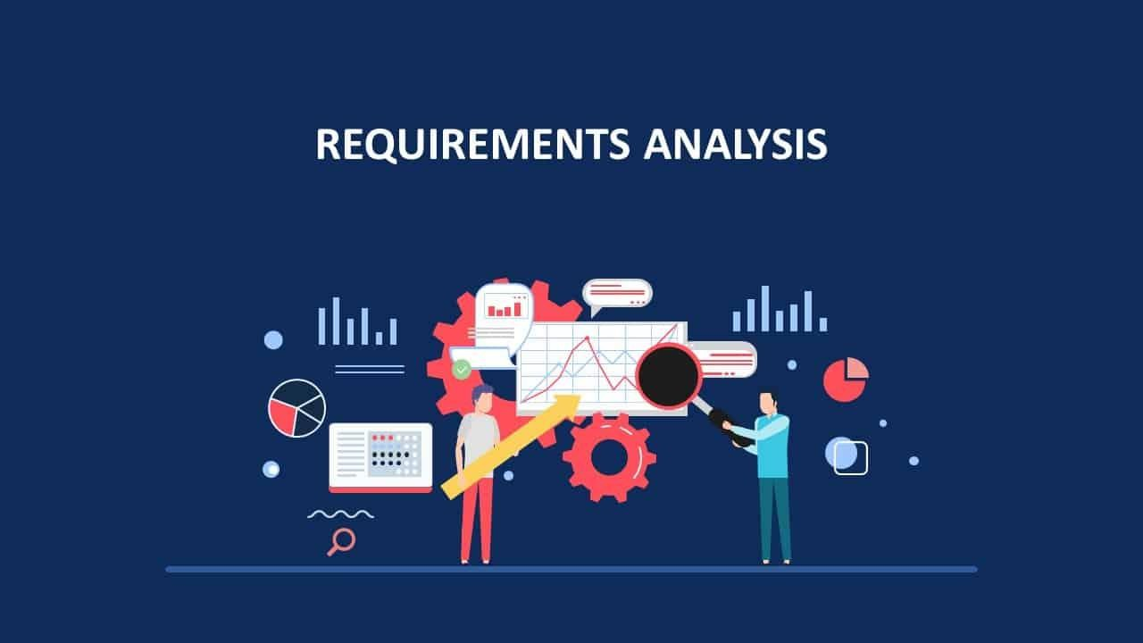
Chapter-2
Requirement and Analysis

Slide 11
2.1) Problem definitioN
Percentage of Accuracy Less
Poor Visibility and Tracking
Inefficiency in Route Planning

Slide 12
2.2) Requirement specification
Identifying needs is the first step while designing a system and implementation.
This is the way to handle user needs. It must be an outgoing process to know requirement of customers during whole system development lifecycle.
Requirements found during all the stage proposed system development are now the present system work.
Time take to operate the system.

Slide 13
2.3) Hardware & software
Hardware Requirement
Hardware Requirement
Processor | Intel P3 Or Higher
RAM | 2/4 GB or More
Hard Disk | 1 GB Recommended
Monitor | Pc, Laptop
Keyboard | Any Simple

Slide 14
2.3) Hardware & software
Software Requirement
Software Requirement
Operating System | Window 11 Or Higher Version
Database | MySQL 5.X
Application Software | Sublime Text, Vs Code, Xampp
Documentations Software | Microsoft Word
Browser | Google Chrome, Brave, Edge

Slide 15
2.4) Planning & scheduling
Determining the objectives of the project to be undertaken.
Estimating resource, funds, material, machines and manpower requirements.
Scheduling various stages and determining the time frame of overall work.
Reducing risk uncertainly.
It provides the basis for co-coordinates the work among concerned; provide a basis predicting & controlling time and cost.

Slide 16
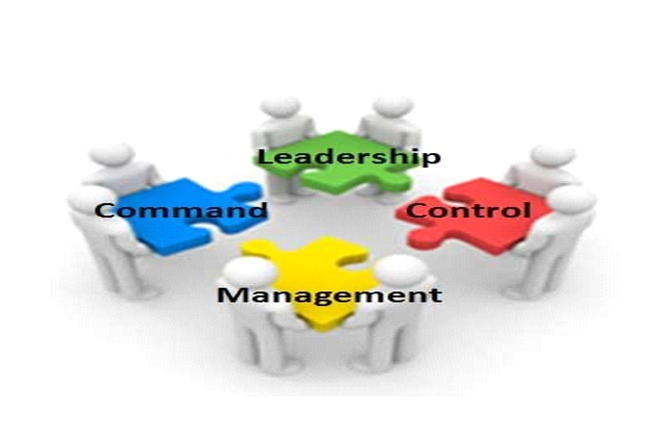
Chapter-3
System Design

Slide 17

3.1 over all system design using designing tools
1) HTML
2) CSS
3) JAVASCRIPT
4) PHP
5) BOOTSTRAP

Slide 18


css
Cascading Style Sheets (CSS)
Simple mechanism
Easy for adding style (e.g., fonts, colours, spacing) to Web documents.
HTML
HTML stands for HYPER TEXT MARKUP LANGUAGE.
HTML is most widely used language on web pages are linked together.
Thus, the link available on a web page is called Hypertext.

Slide 19

javascript
Java script is a lightweight , interpreted programming language.
It is designed for creating network-centric applications.
It is complimentary to and integrated with java.
It is open and cross-platform.
Java script is very easy to implement because it is integrated with HTML.

Slide 20

php
PHP stands for PHP: Hypertext Pre-processor
PHP is a server-side scripting language, like ASP
PHP scripts are executed on the server
PHP supports many databases (MYSQL, Informix, Oracle, Sybase, Solid, Generic ODBC, etc.)
PHP is an open source software
PHP is free to download and use

Slide 21
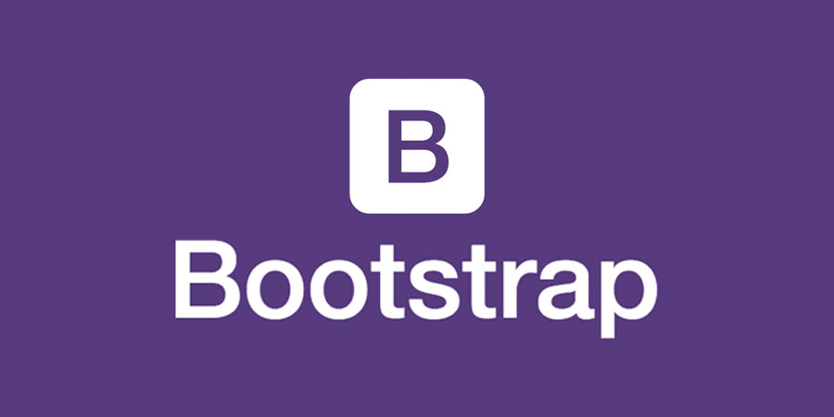
BOOTSTRAP
Bootstrap is an open-source front-end Frame-work.
User friendly approach.
It is for creating responsive website and web applications.
It contains HTML, CSS and JAVASCRIPT

Slide 22

Diagram
3.1.1 Use Case Diagram
3.1.2 DFD Diagram
3.1.3 Activity diagram
3.1.4 Sequence Diagram
3.1.5 ER Diagram

Slide 23
3.1.1) Use-Case Diagram
A use case diagram at its simplest is presentation of a user’s interaction with the system that shows the relationship between the user and the different use cases in which the user is involved. A use case diagram can identify the different types of users of a system and the different use cases.

Slide 24


Use-Case Notation
Notation | Name
 | Actor
 | Use Case
 | System Boundary
 | Dataflow (Relationship)

Slide 25
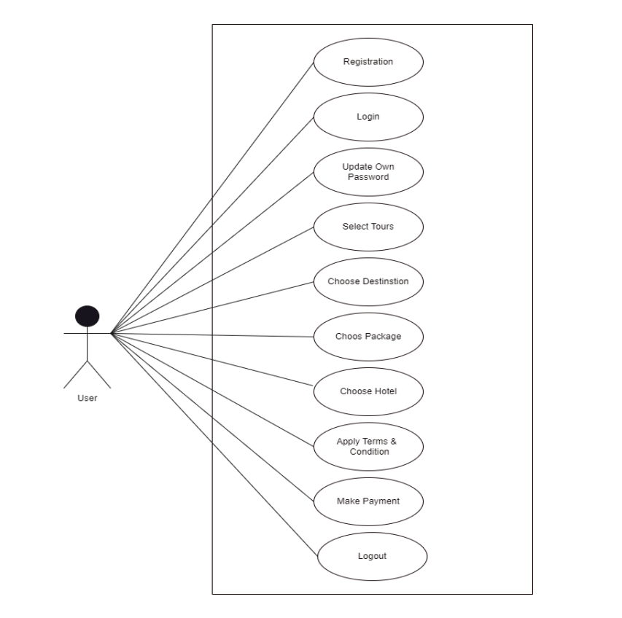
Use Case Diagram : User

Slide 26
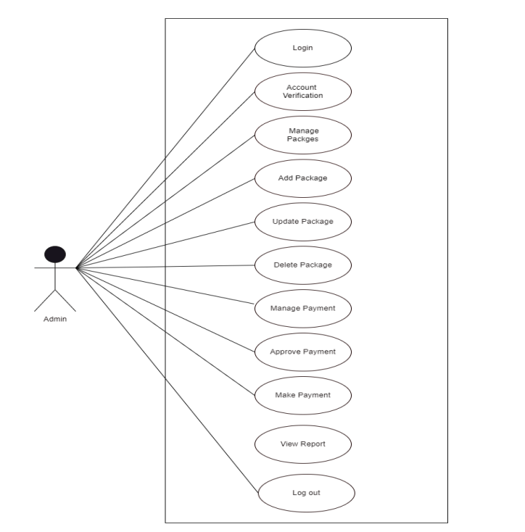
Use Case Diagram : Admin

Slide 27
3.1.2) Data FLOW DIAGRAM
Notations
Notation | Name
 | Data Store
 | Process
 | Entity
 | Dataflow (Relationship)

Slide 28
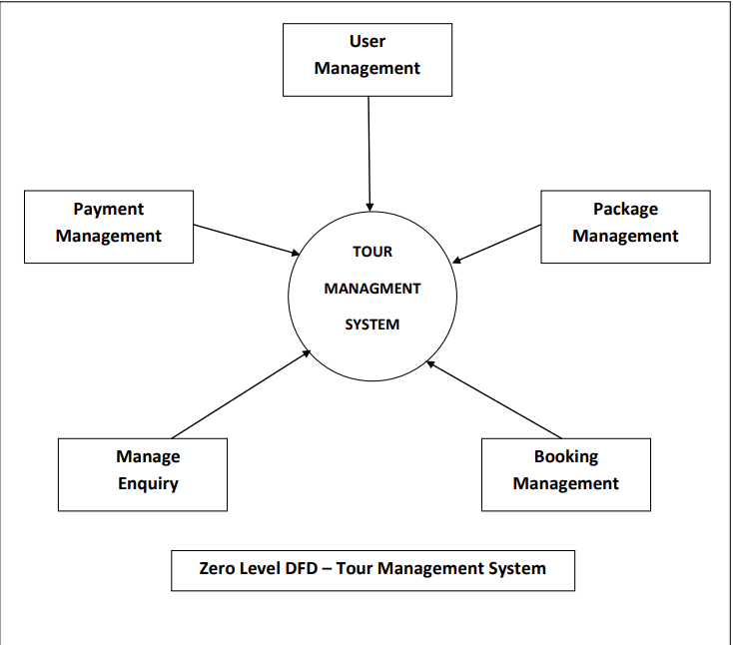
Data-Flow Diagram : Zero Level

Slide 29
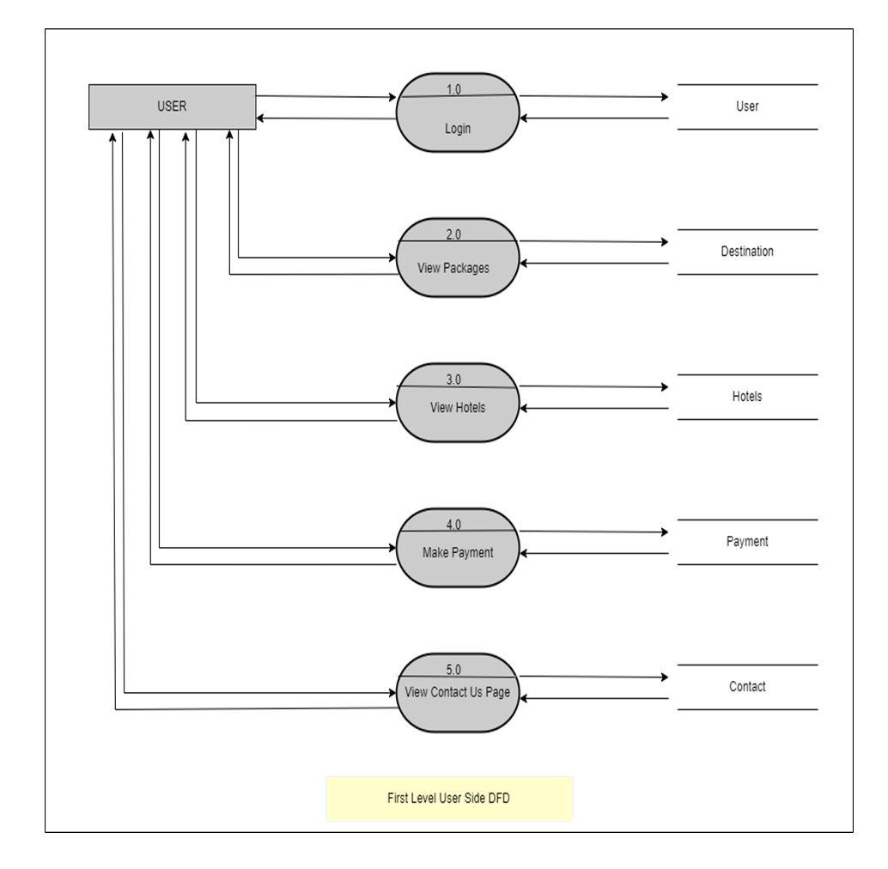
First Level DFD : User

Slide 30
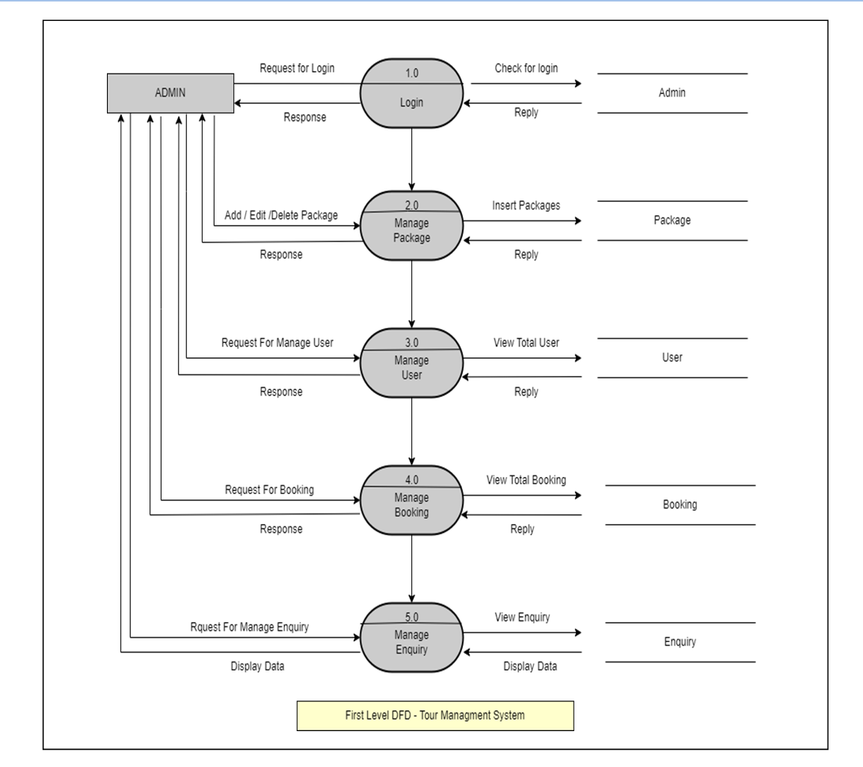
First Level DFD : Admin

Slide 31
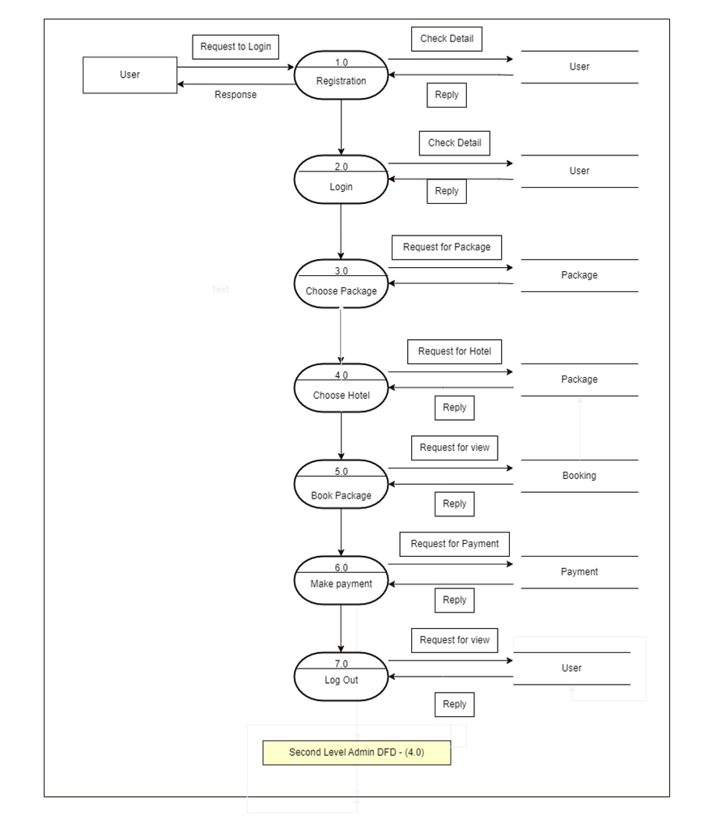
Second Level DFD : User

Slide 32
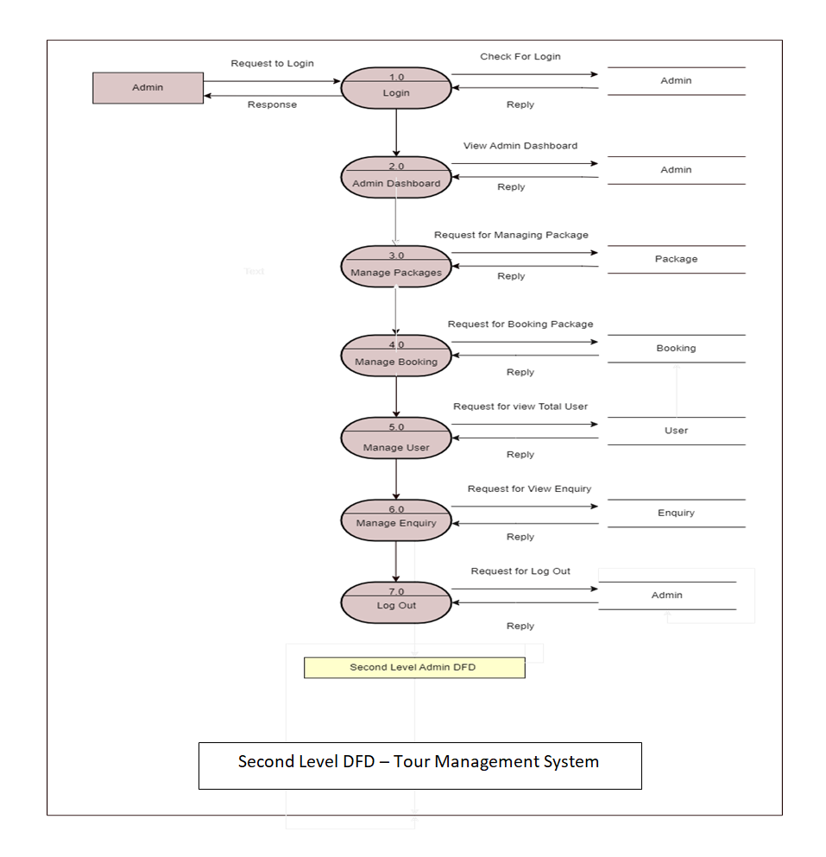
Second Level DFD : Admin

Slide 33
3.1.3) Activity Diagram
Typically, an event needs to be achieved by some operations, particularly where the operation is intended to achieve a number of different things that require co-ordination, or how the events in a single use case relate to one another, in particular, use cases where activities may overlap and require co-ordination
Activity Diagrams describe how activities are coordinated to provide a service which can be at different levels of abstraction.

Slide 34

Activity Diagram Notation
Initial State
Activity or Action state
Action Flow
Decision
Joint Symbol
Fork
End

Slide 35
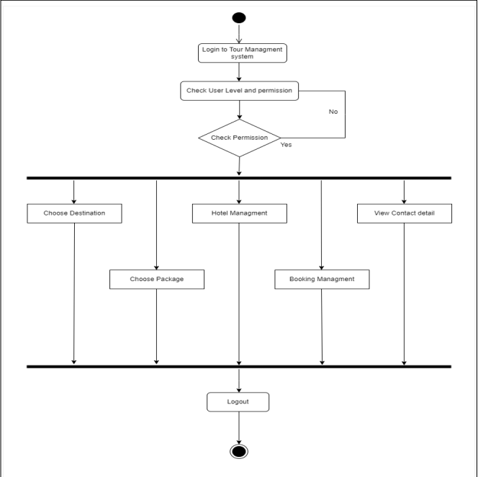
Activity Diagram : User

Slide 36
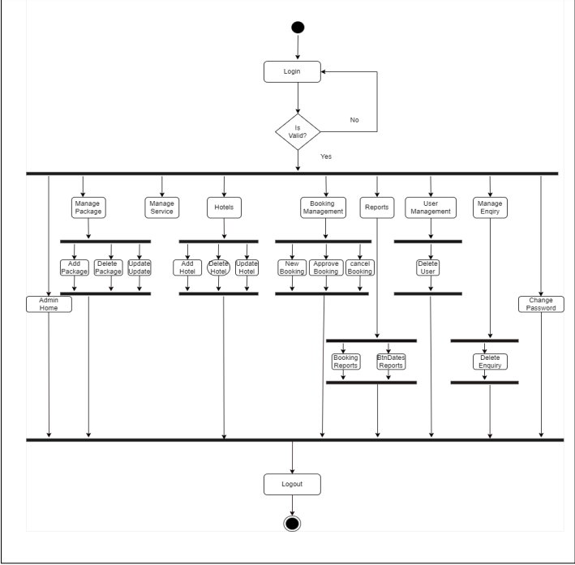
Activity Diagram : Admin

Slide 37
3.1.4) Sequence Diagram
Notations
Name | Symbol | Description
Synchronous Message |  | When the sender has to wait for a response to a message before it can continue, the symbol for the synchronous message is used.
Call Message |  | A message defines a particular communication between Lifelines of an Interaction.
Return Message |  | Return message is a kind of message that represents the pass of information back to the caller of a corresponded former message

Slide 38
Sequence Diagram Notation
Name | Symbol | Description
Delete Message |  | The Delete Message symbol is used to delete an object. This is represented by adding an “X” at the endof an arrow.
Self Message |  | In the case where an object needs to send a message to itself, the self message notation is used. It is done using a U-Shaped arrow.
Object |  | Depicted with rectangle shape, object represent and instances of class f needed
Bar |  | These are used to show the start and end of concurrent in the diagram.

Slide 39
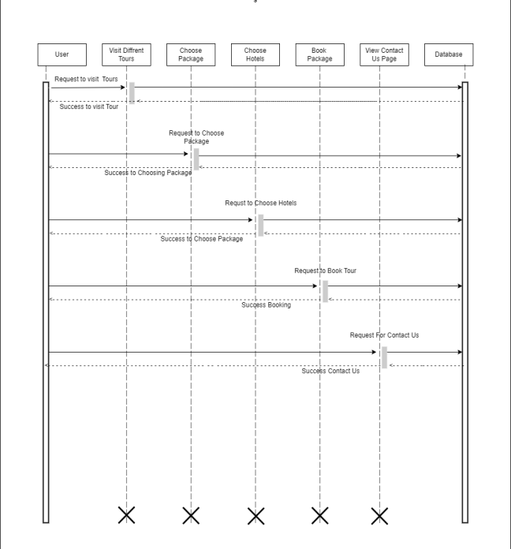
Sequence Diagram : User

Slide 40
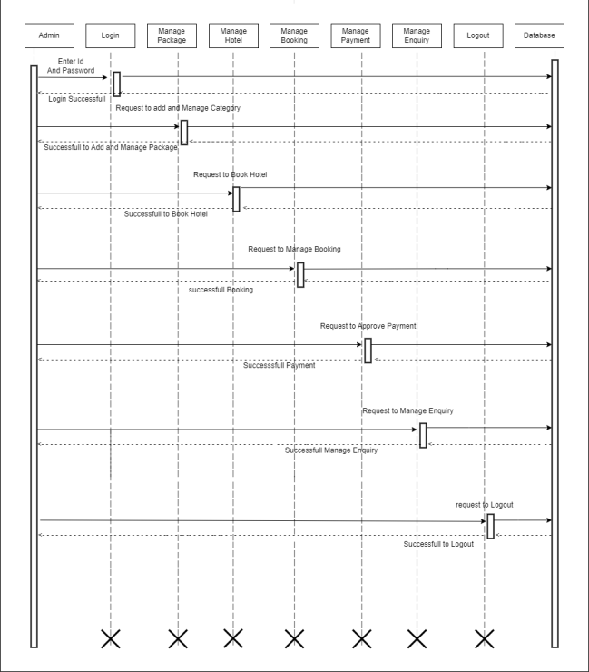
Sequence Diagram : Admin

Slide 41
3.1.4) ER Diagram
Notations
Notation | Name
 | Mandatory Relationship Partial Participation
 | Attributes
 | Entity
 | Relationship

Slide 42
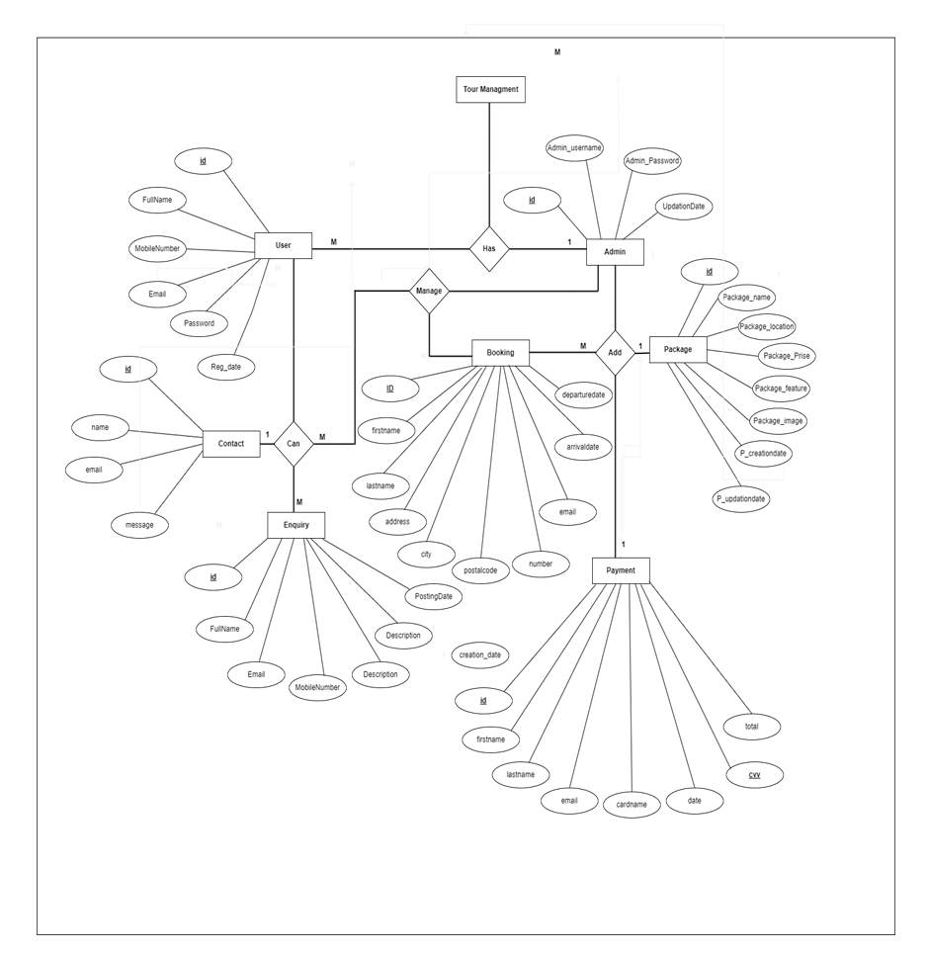
ER Diagram :

Slide 43
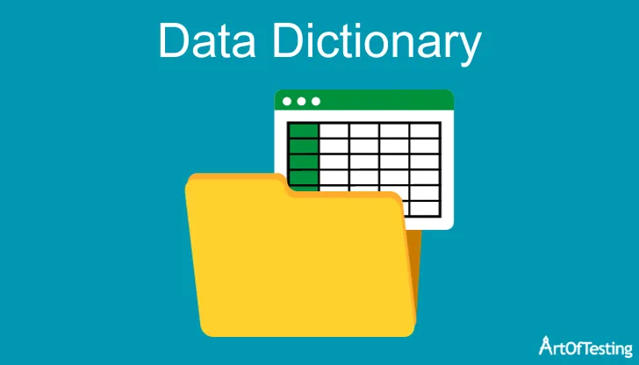
3.2) data dictionary (tables)
3.2.1 Table Definition
3.2.2 Table specification

Slide 44
Table 01-Admin
Field Name | Data Type | Primary key | Allow Null | Allow Auto Increment
Id | Int(10) | True | Yes | Yes
Username | Varchar(10) | False | Yes | No
Password | Varchar(20) | False | Yes | No
Updationdate | Timestamp | False | Yes | No

Slide 45
Table 02 - Booking
Field Name | Data Type | Primary key | Allow Null | Allow Auto Increment
id | int(10) | True | No | Yes
firstname | Varchar(10) | False | No | No
lastname | Varchar(20) | False | No | No
address | Varchar(30) | False | No | No
city | Varchar(20) | False | No | No
postlcode | int(6) | False | No | No
number | int (10) | False | No | No
email | Varchar(20) | False | No | No
arrivaldate | Timestamp | False | No | No
departuredate | Timestamp | False | No | No

Slide 46
Table 03 - Packages
Field Name | Data Type | Primary key | Allow Null | Allow Auto Increment
P.id | int(10) | True | No | Yes
P.Name | Varchar(10) | False | No | No
P.Type | Varchar(20) | False | No | No
P.Location | Varchar(10) | False | No | No
P.Price | int(5) | False | No | No
P.Features | Varchar(50) | False | No | No
P.Details | Varchar(100) | False | No | No
P.Image | Varchar(10) | False | No | No
P.CreationDate | Timestamp | False | No | No
P.UpdationDate | Timestamp | False | No | No

Slide 47
Table 04 - User
Field Name | Data Type | Primary key | Allow Null | Allow Auto Increment
Id | int(10) | True | No | Yes
FullName | varchar(10) | False | No | No
EmailId | varchar(20) | False | No | No
MobileNo | int(10) | False | No | No
Password | int(10) | False | No | No
RedDate | Timestamp | False | No | No
UpdationDate | Timestamp | False | No | No
RedDate | Timestamp | False | No | No
Id | int(10) | True | No | Yes
FullName | varchar(10) | False | No | No

Slide 48
Table 05 - Enquiry
Field Name | Data Type | Primary key | Allow Null | Allow Auto Increment
id | int(10) | True | No | Yes
FullName | Varchar(10) | False | No | No
Email | Varchar(20) | False | No | No
Mobile | int(10) | False | No | No
Subject | Varchar(20) | False | No | No
Description | Varchar(100) | False | No | No
Posting Date | Timestamp | False | No | No
P.Status | Varchar(50) | False | No | No

Slide 49
Table 06 - Payment
Field Name | Data Type | Primary key | Allow Null | Allow Auto Increment
id | int(10) | True | No | Yes
FirstName | Varchar(10) | False | No | No
Lastname | Varchar(10) | False | No | No
Email | Varchar(10) | False | No | No
Card Number | Int(14) | Yes | No | No
Date | Timestamp | False | No | No
CVV Number | Int(3) | Yes | No | No
Total | int(5) | False | No | No

Slide 50
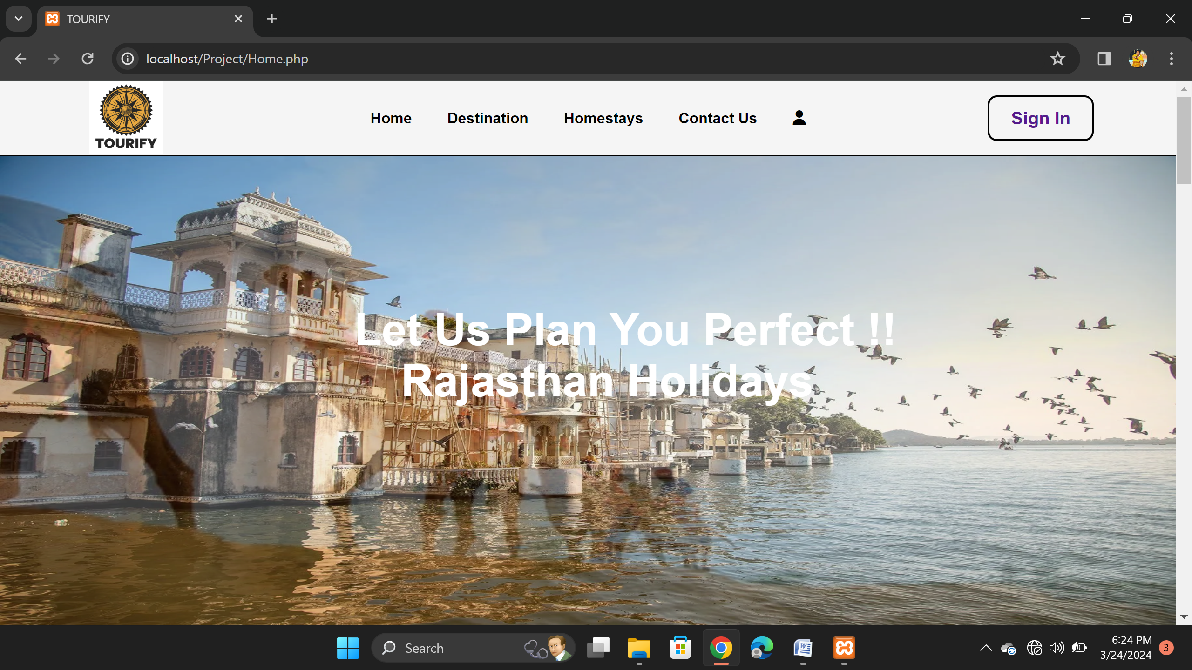
3.3) input / output design (ss)
Home Page

Slide 51
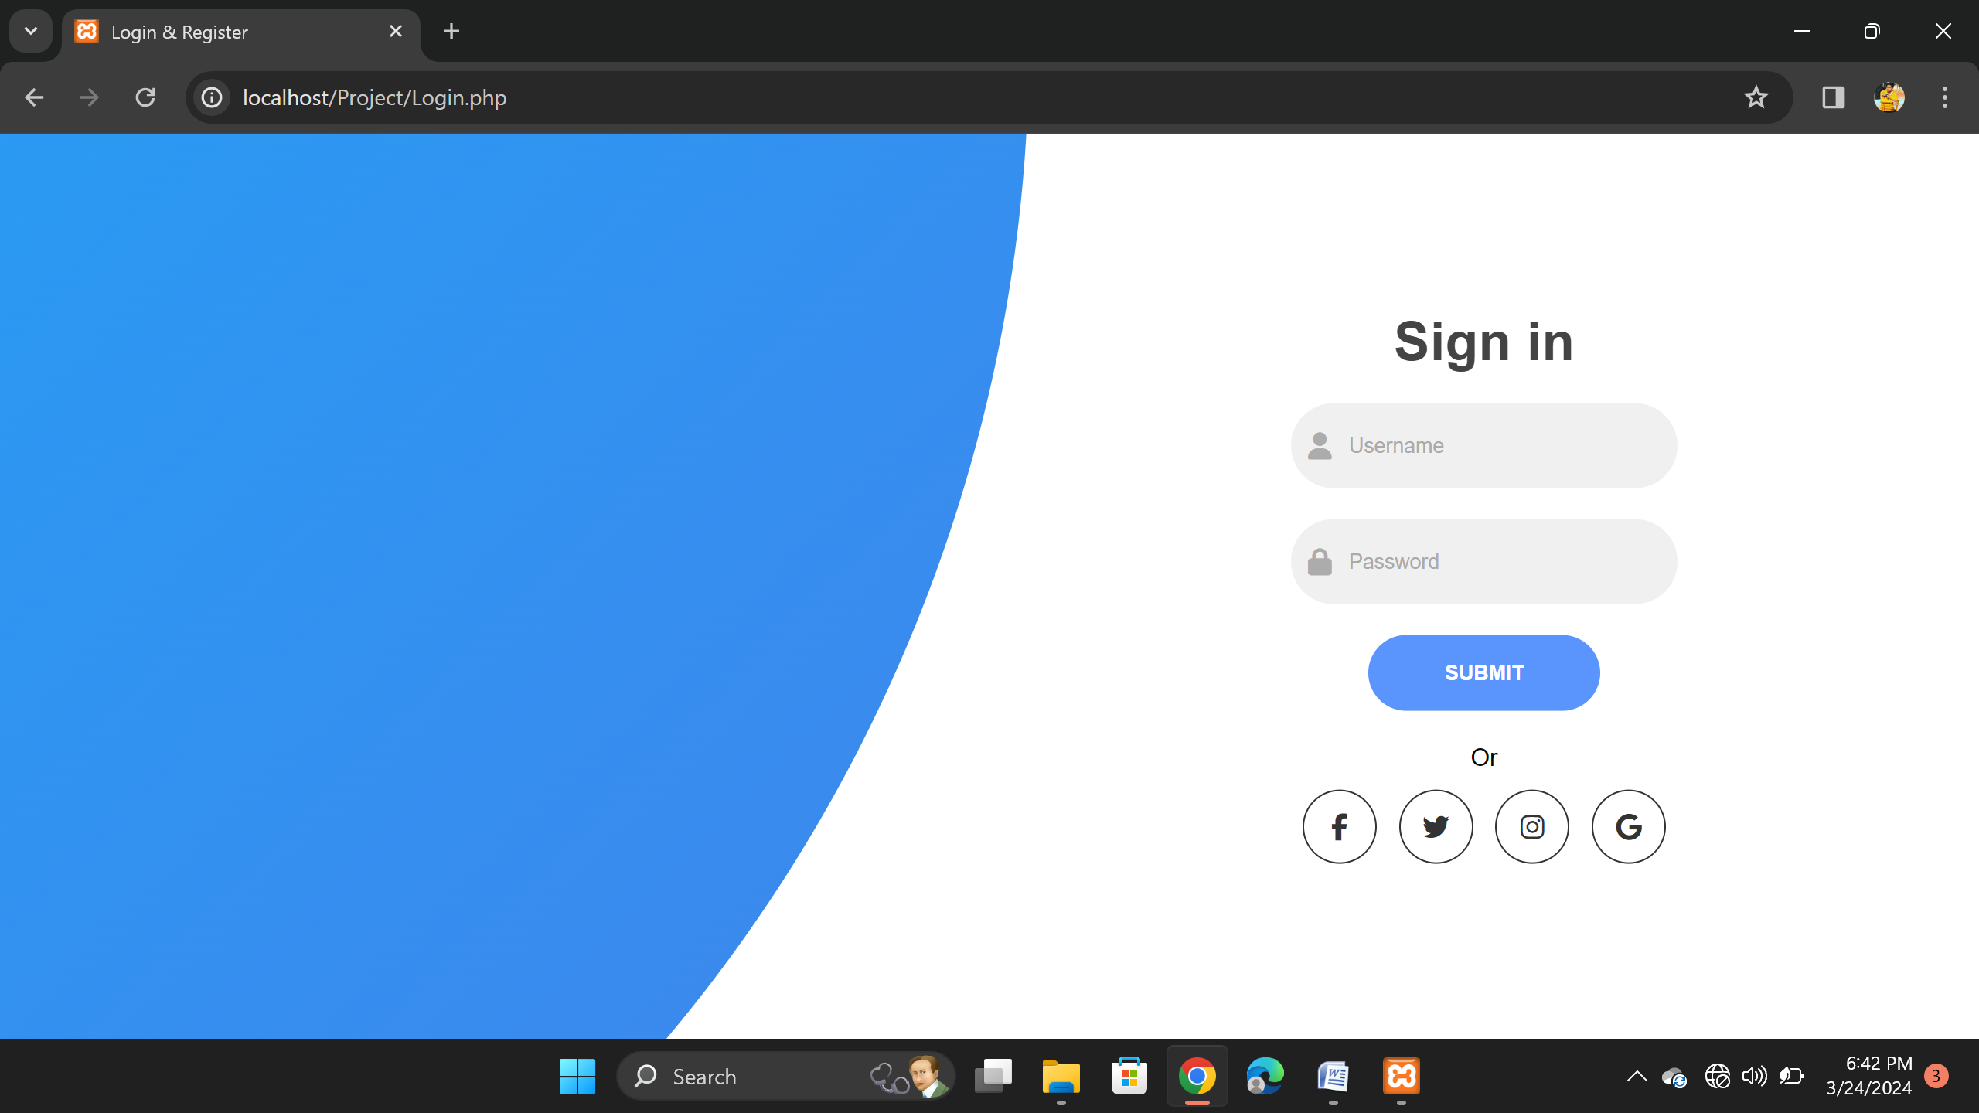
User Login Page

Slide 52
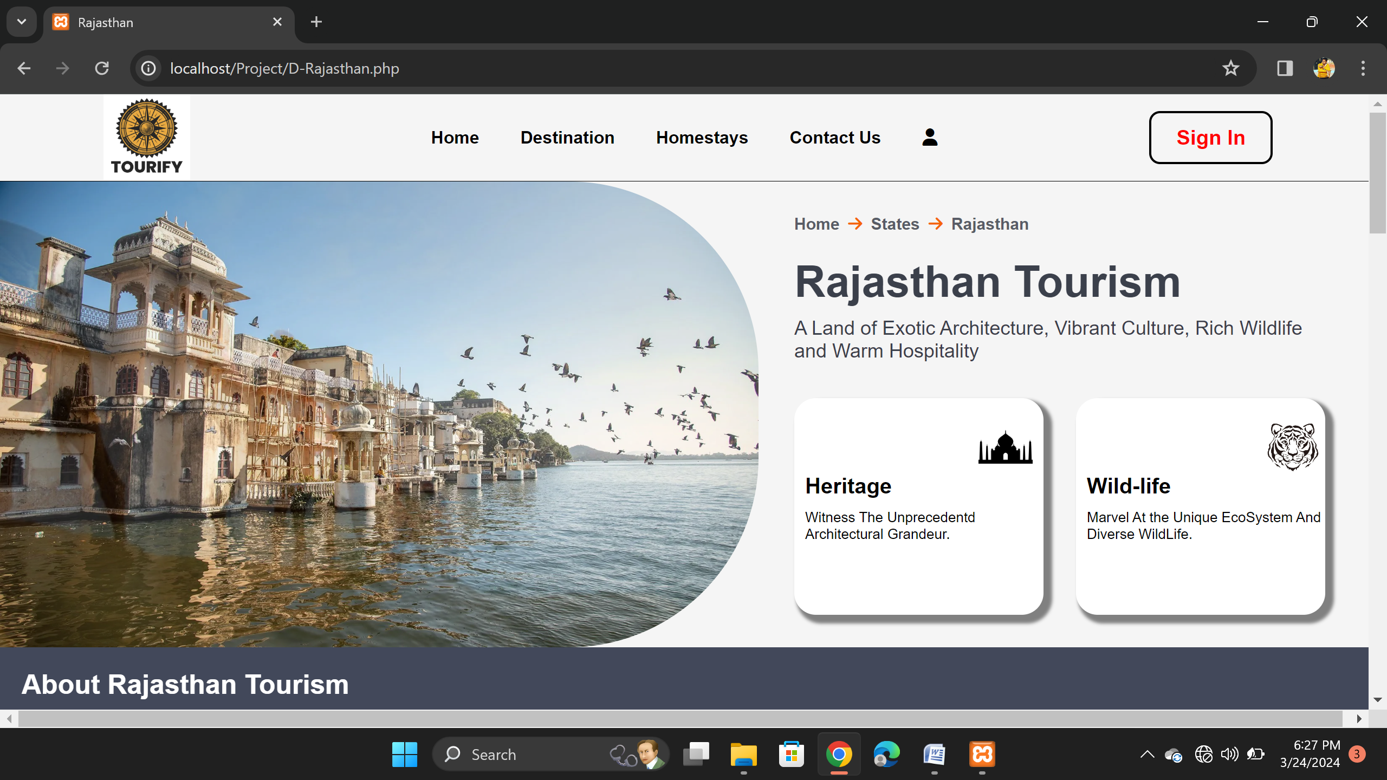
Destination Page

Slide 53
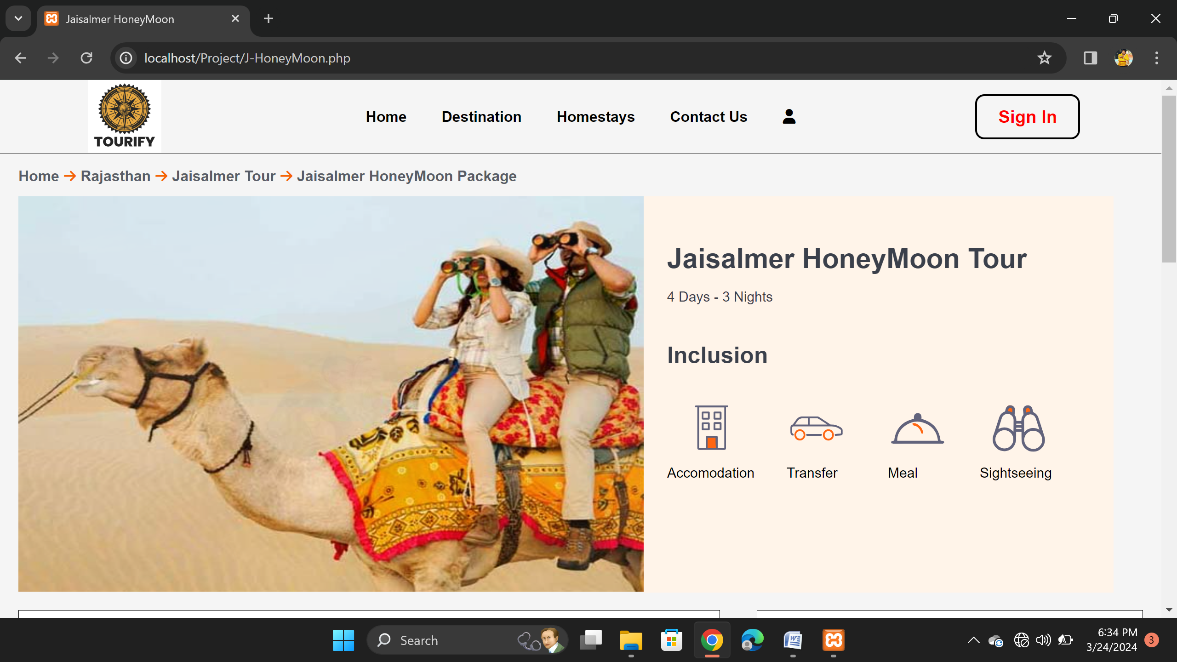
Honeymoon Package

Slide 54
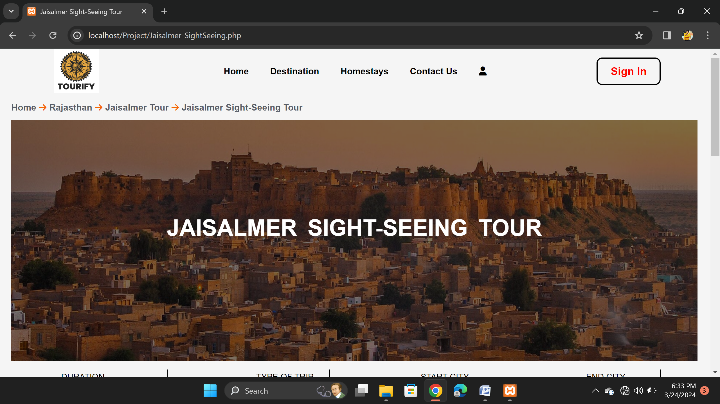
Sightseeing Package

Slide 55
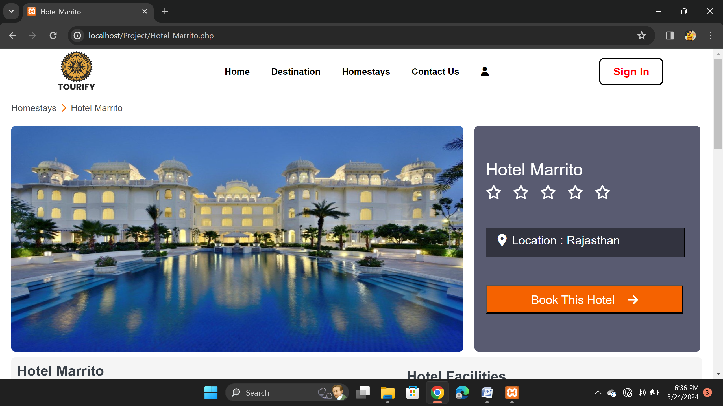
Homestays Page
Hotel Marrito

Slide 56
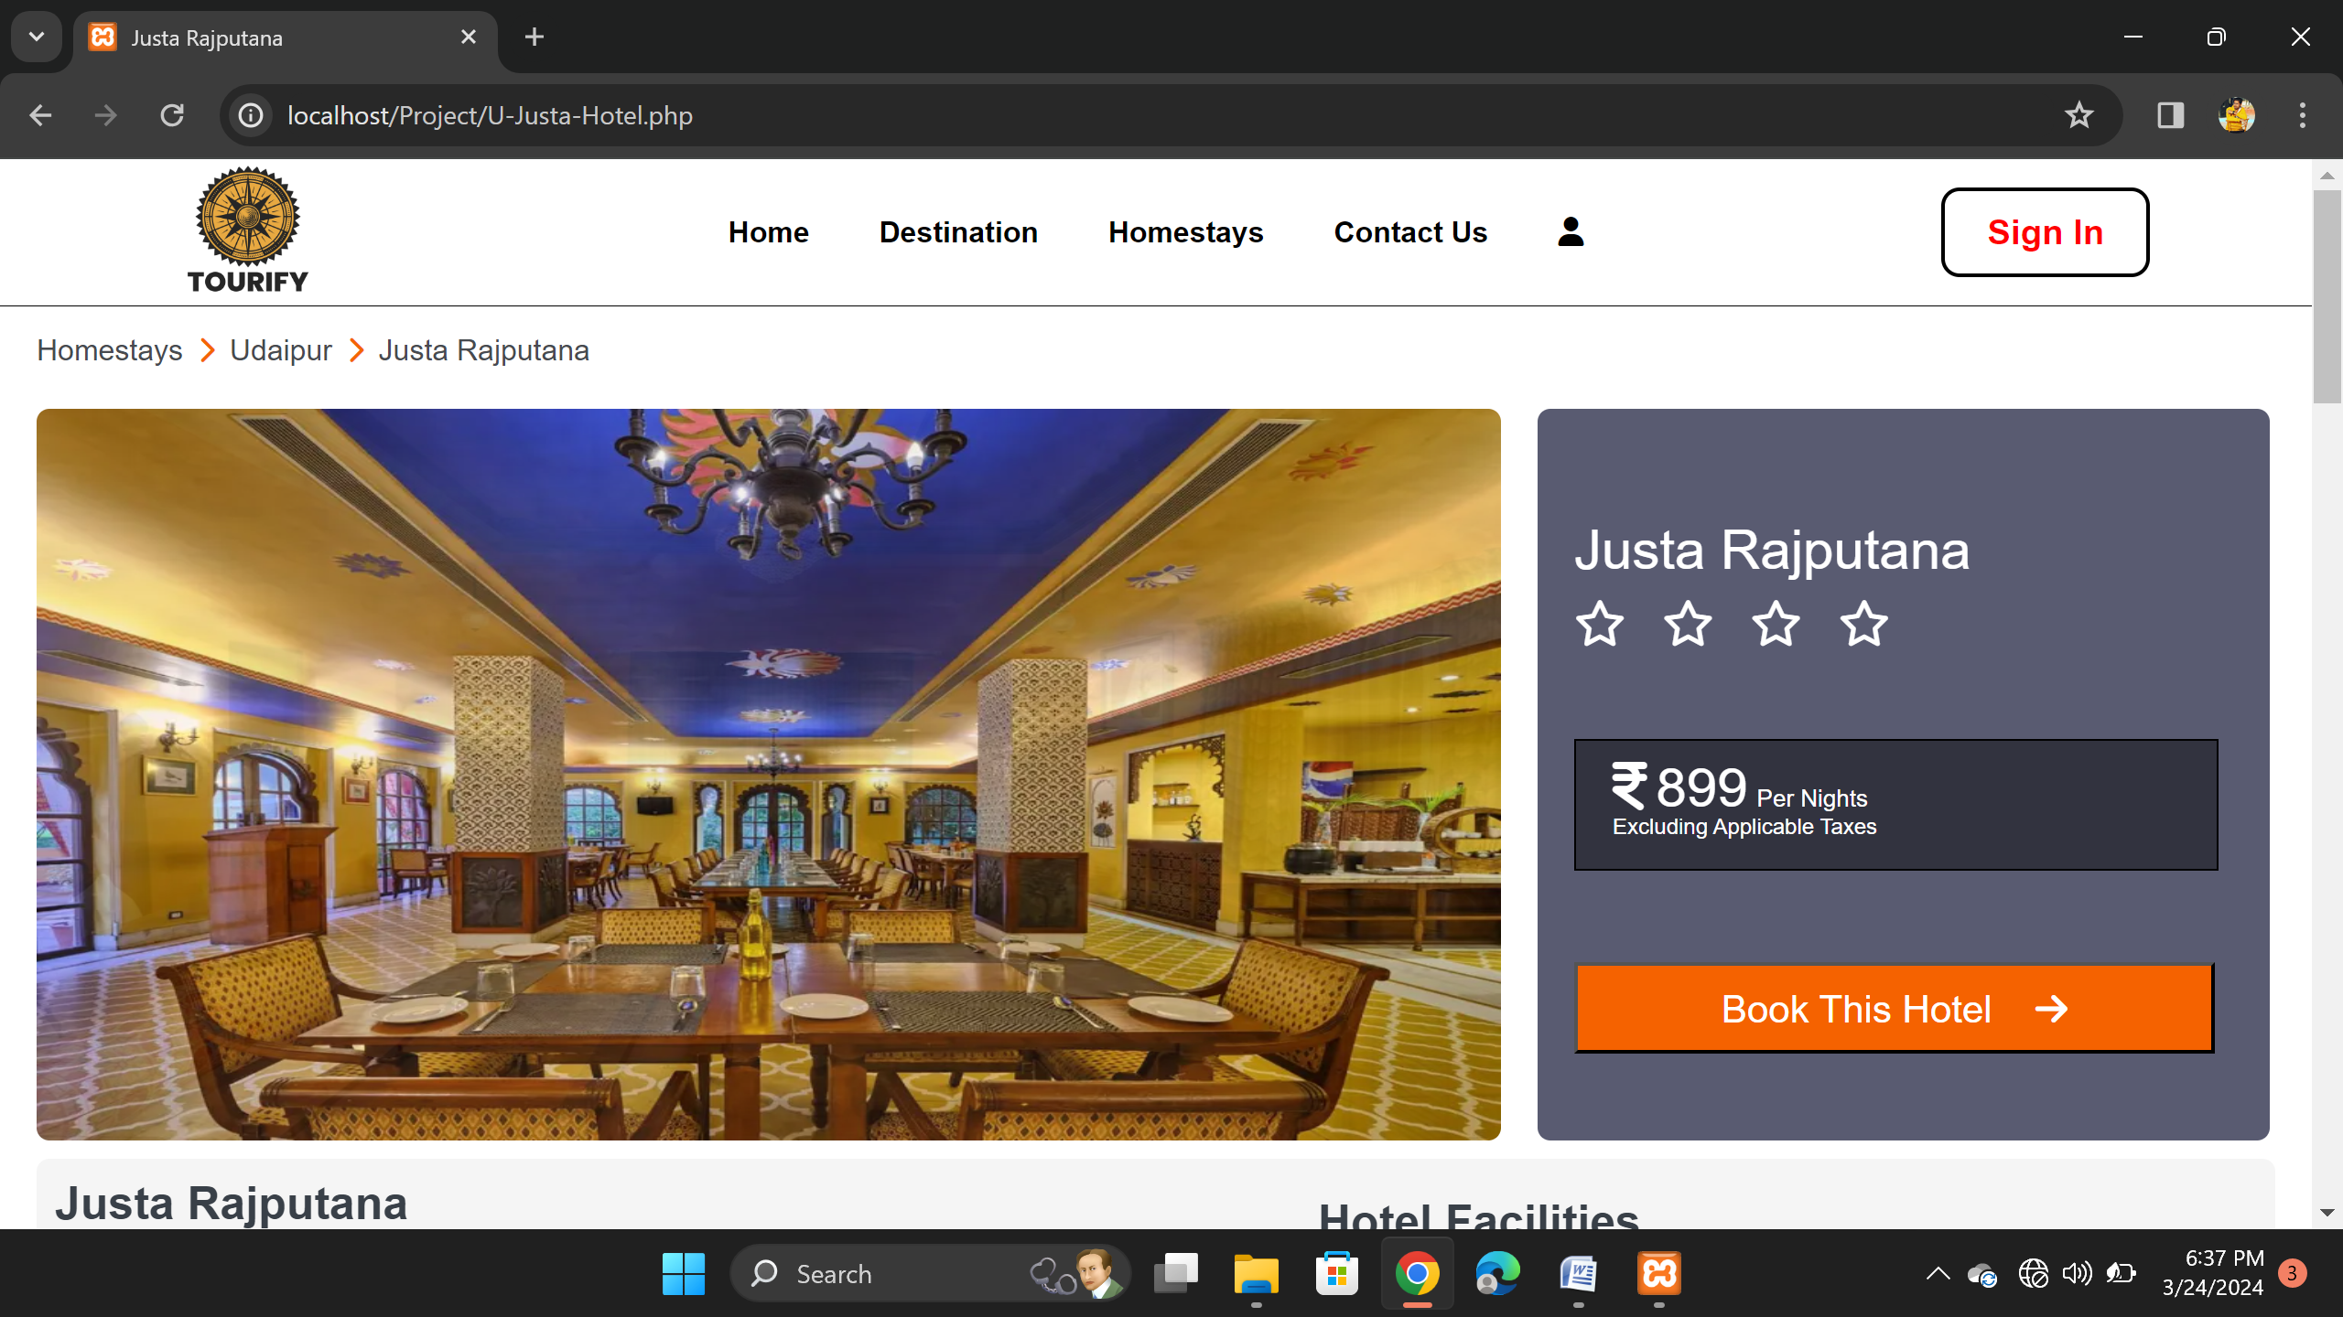
Homestays Page
Hotel Rajputana

Slide 57
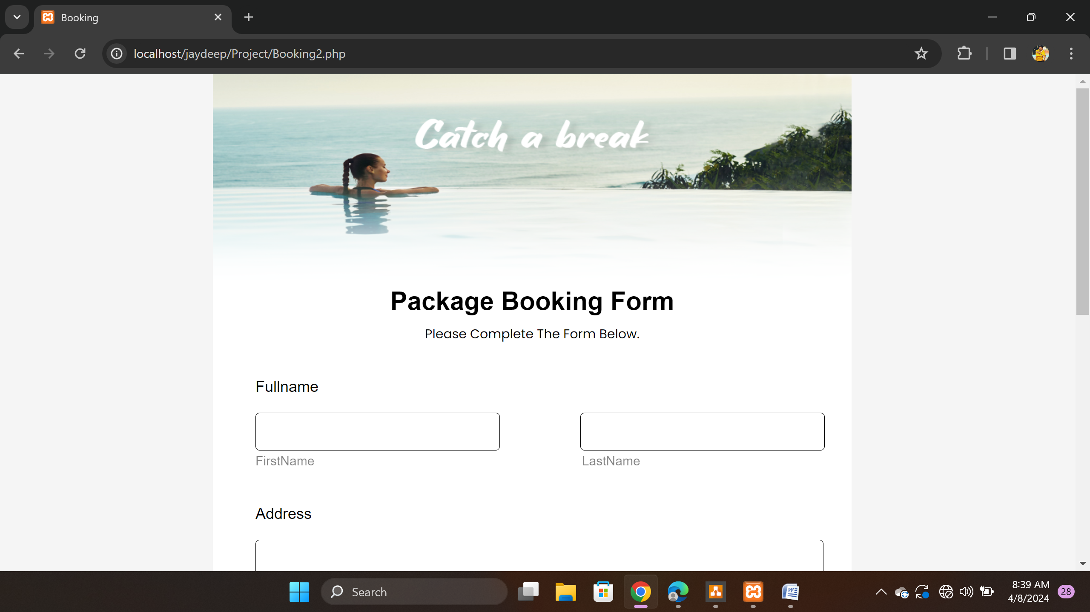
Booking Page

Slide 58
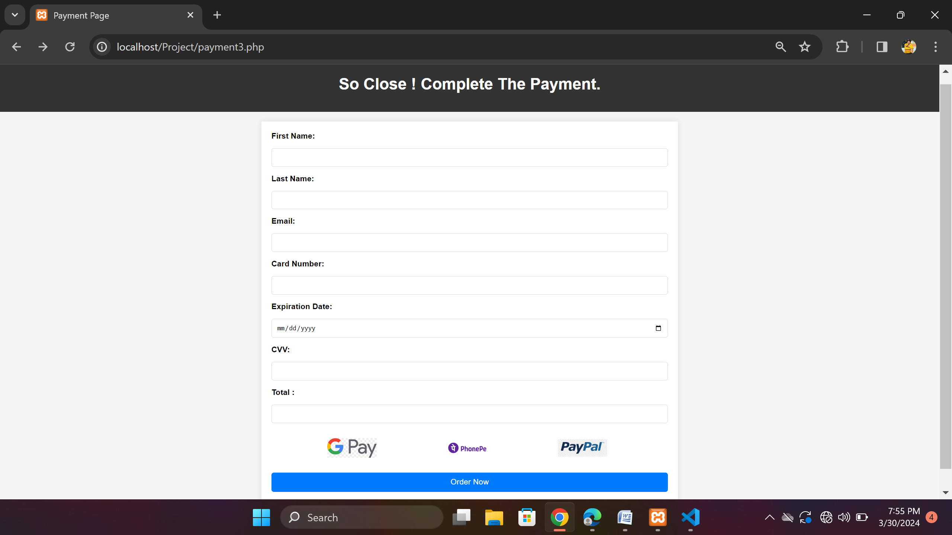
Payment Page

Slide 59
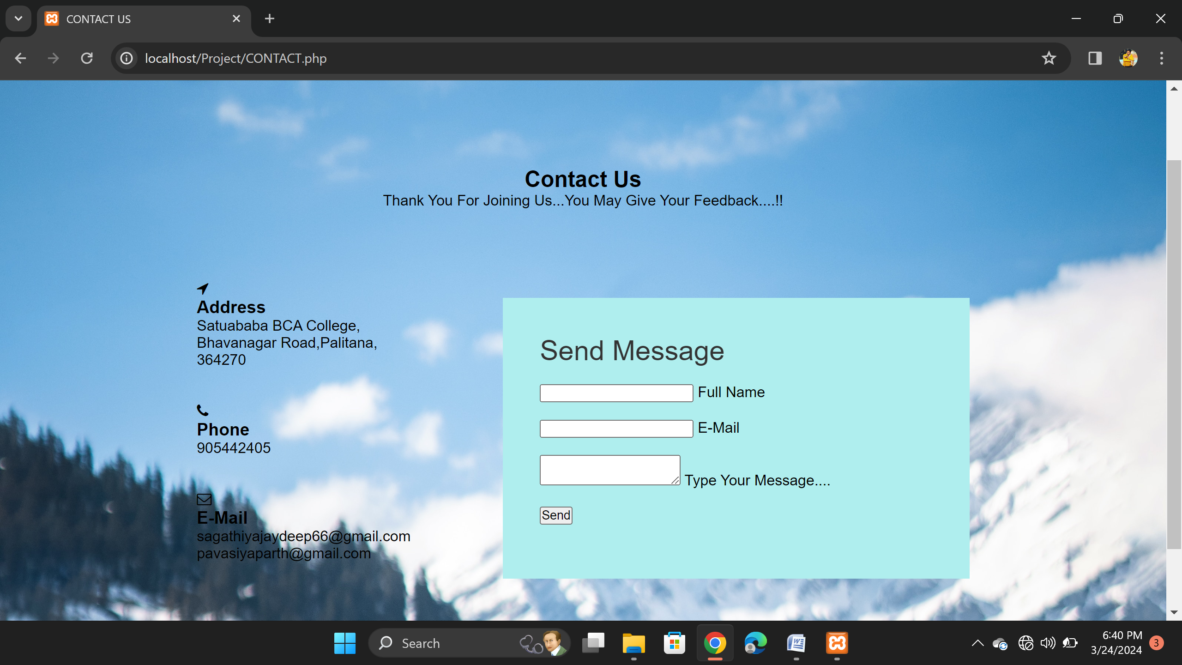
Contact Us Page

Slide 60
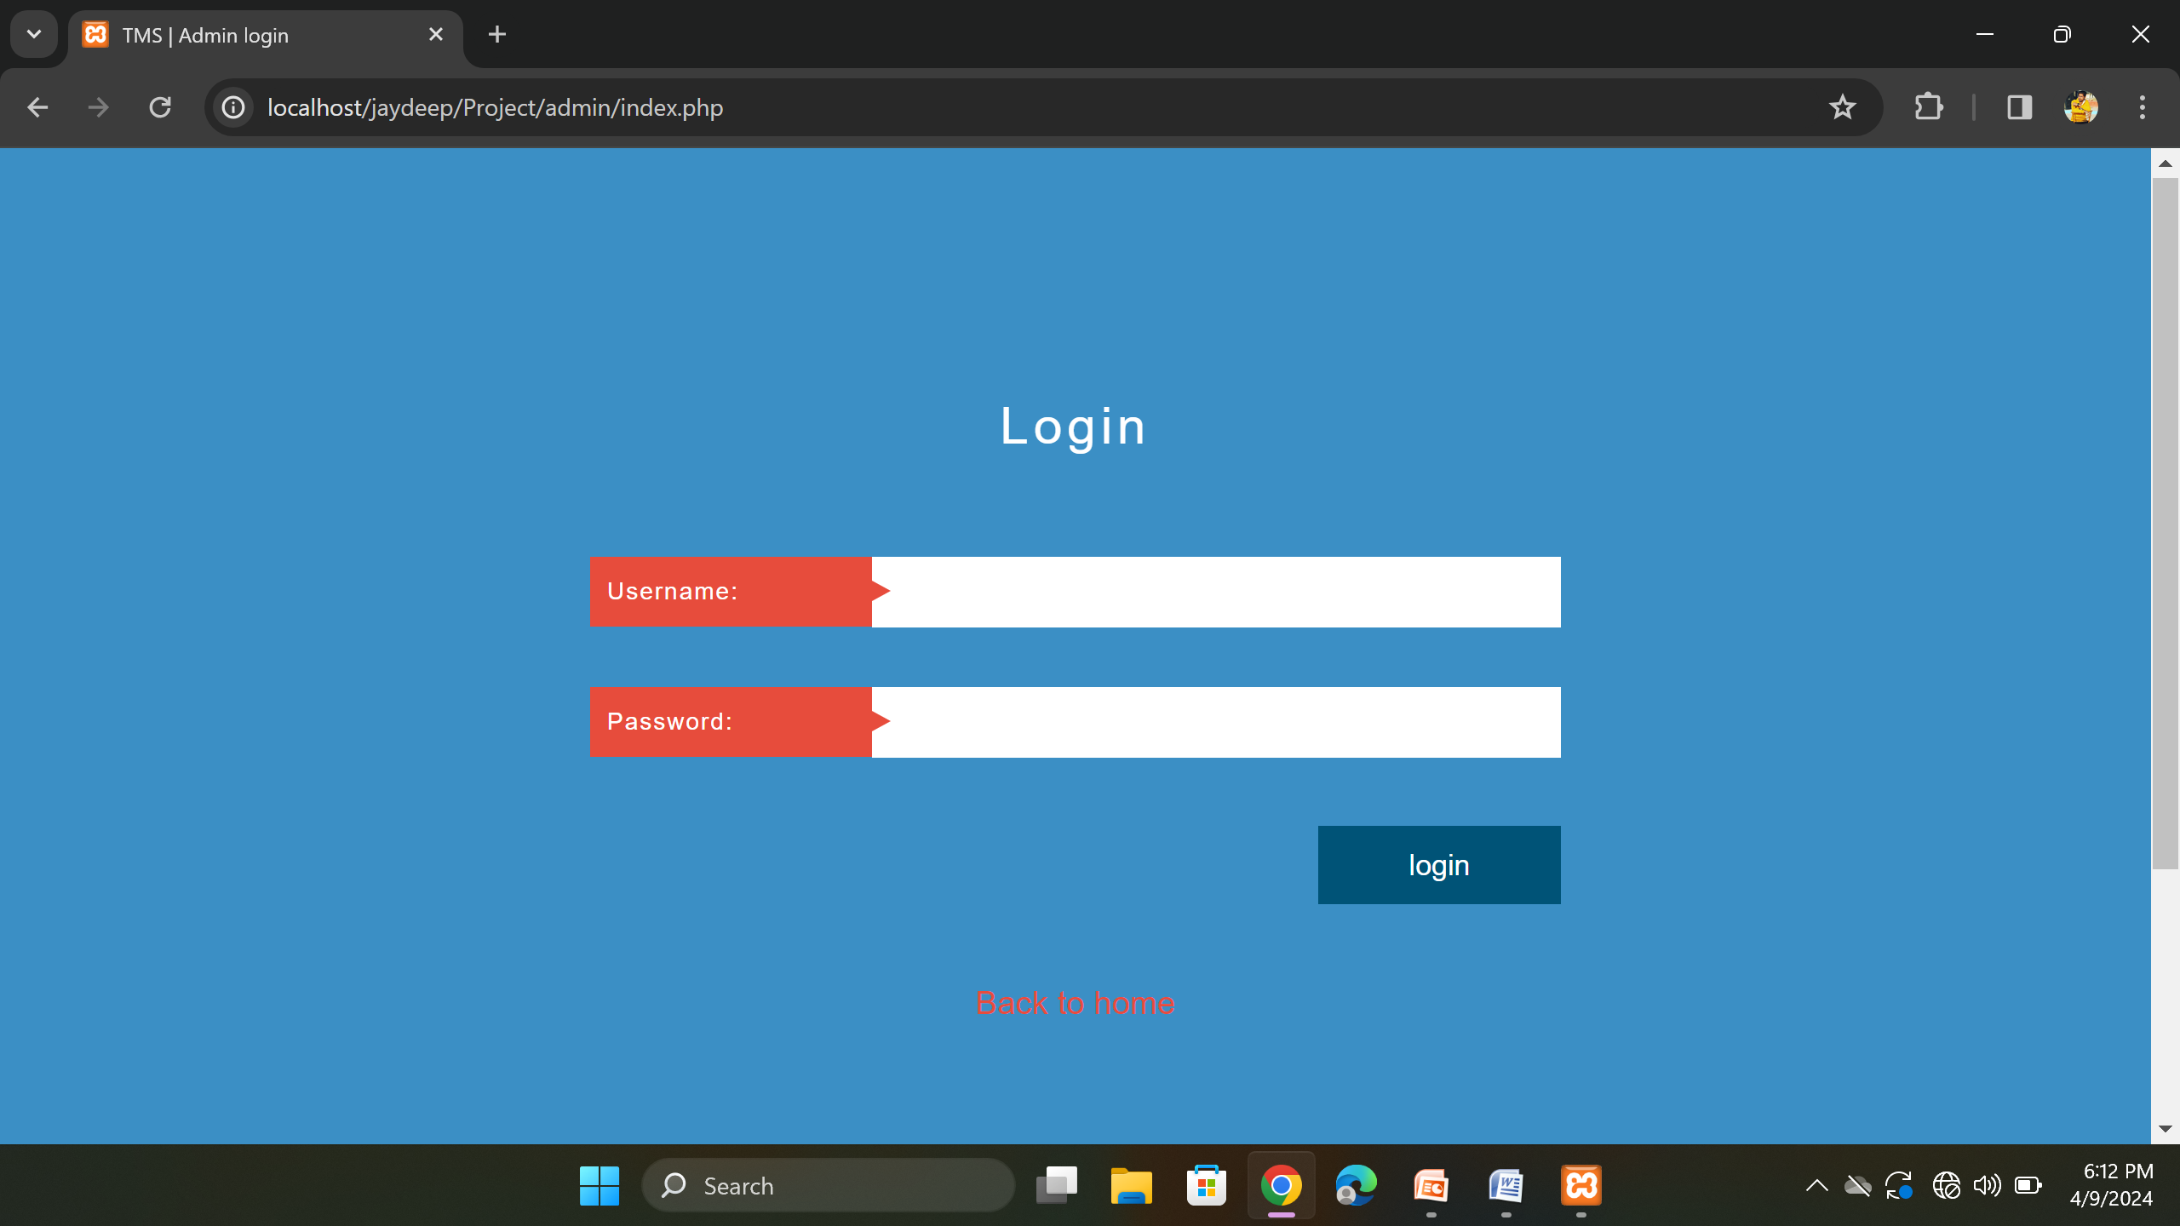
Admin Login Page

Slide 61
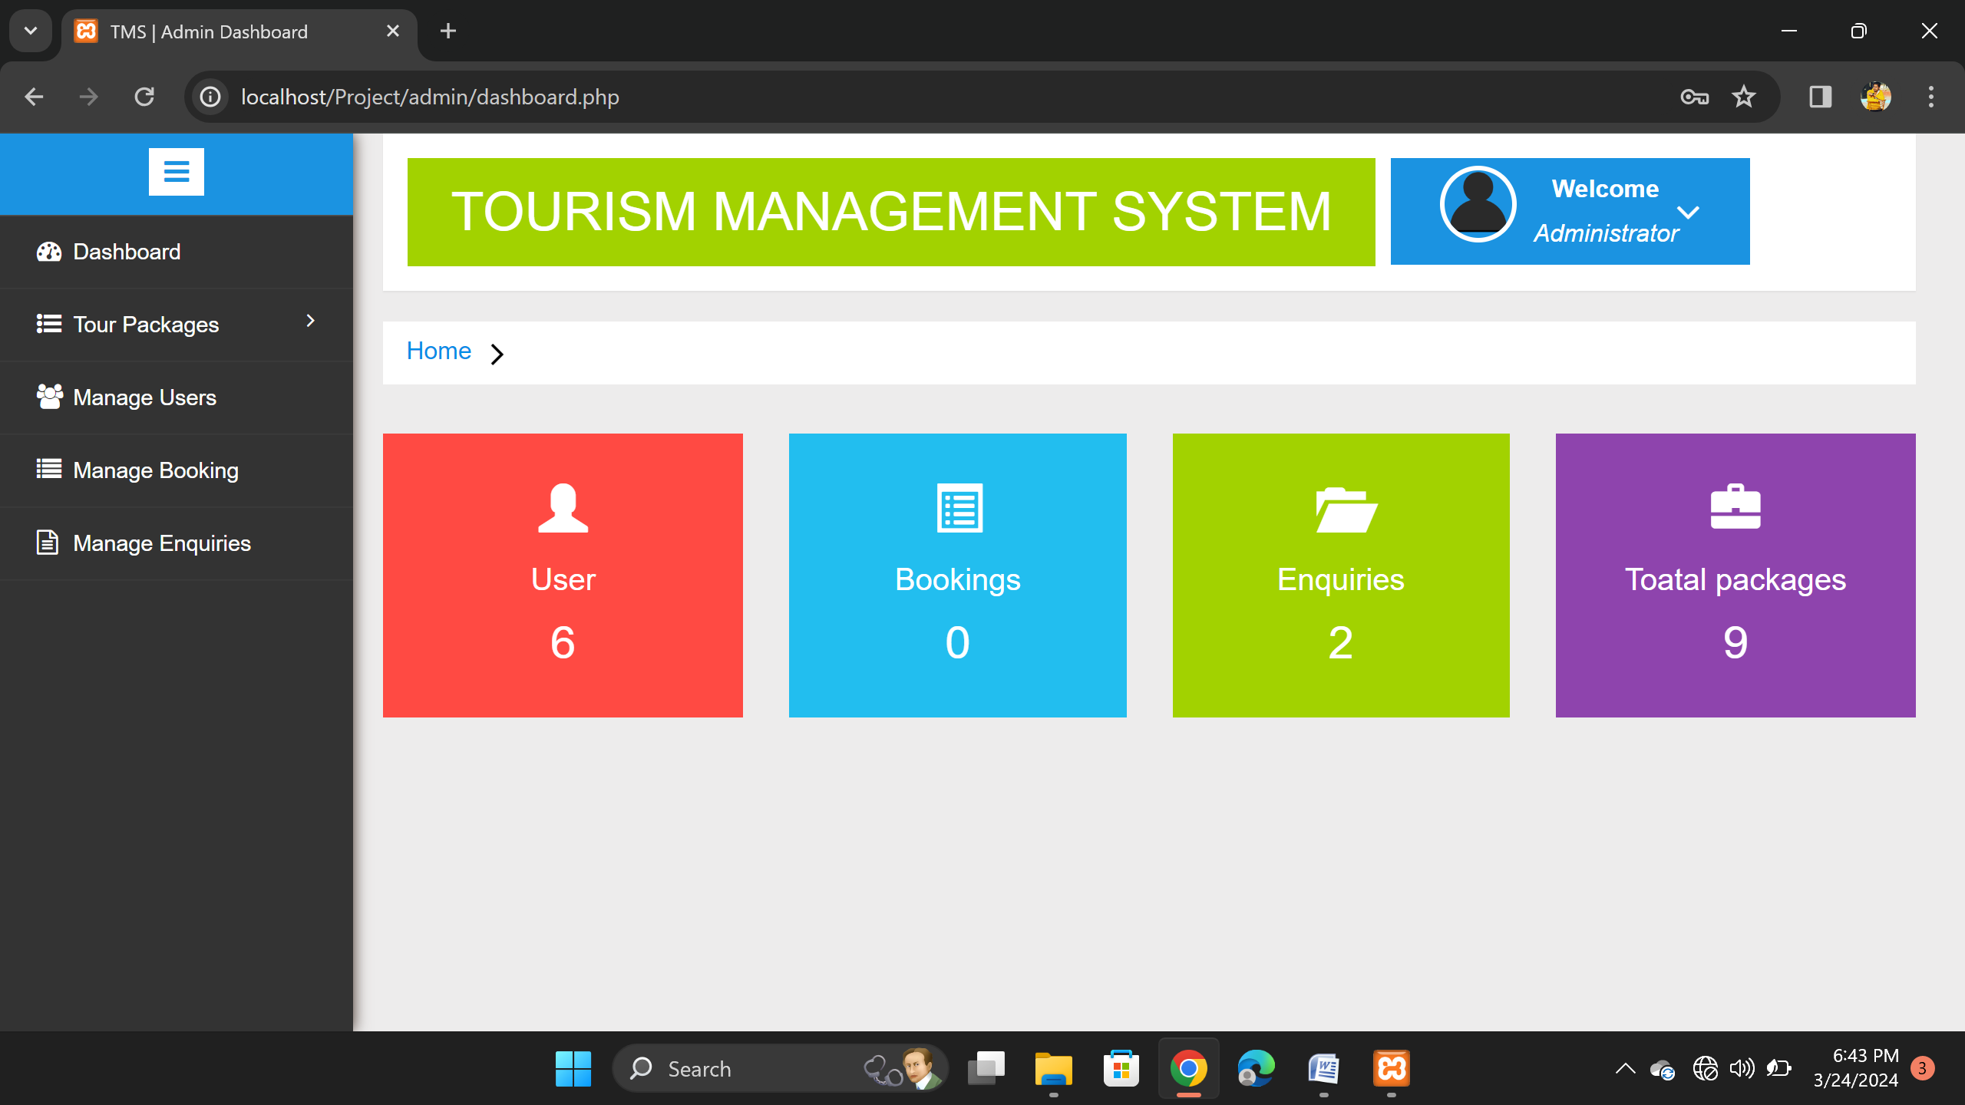
Admin Dashboard

Slide 62
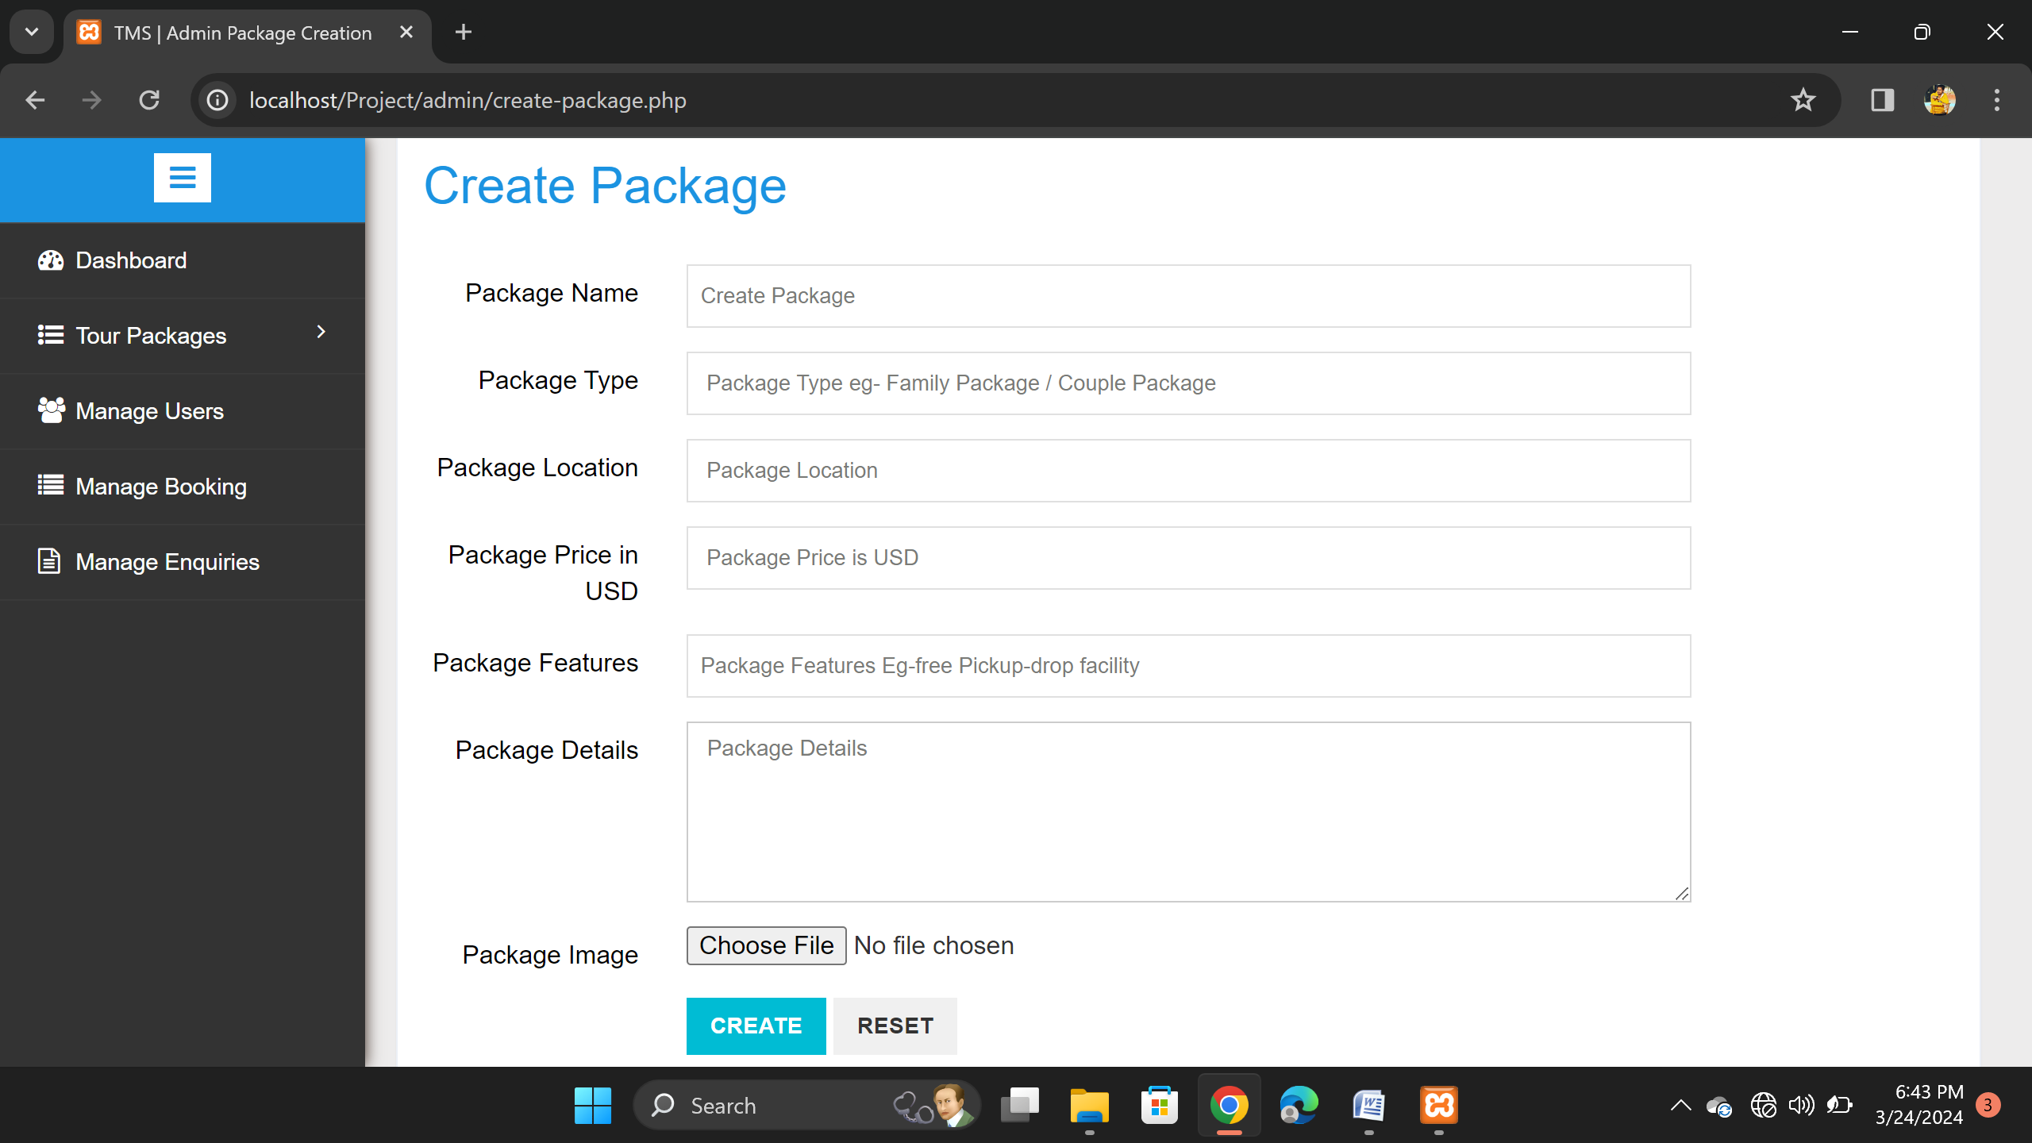
Create Package

Slide 63
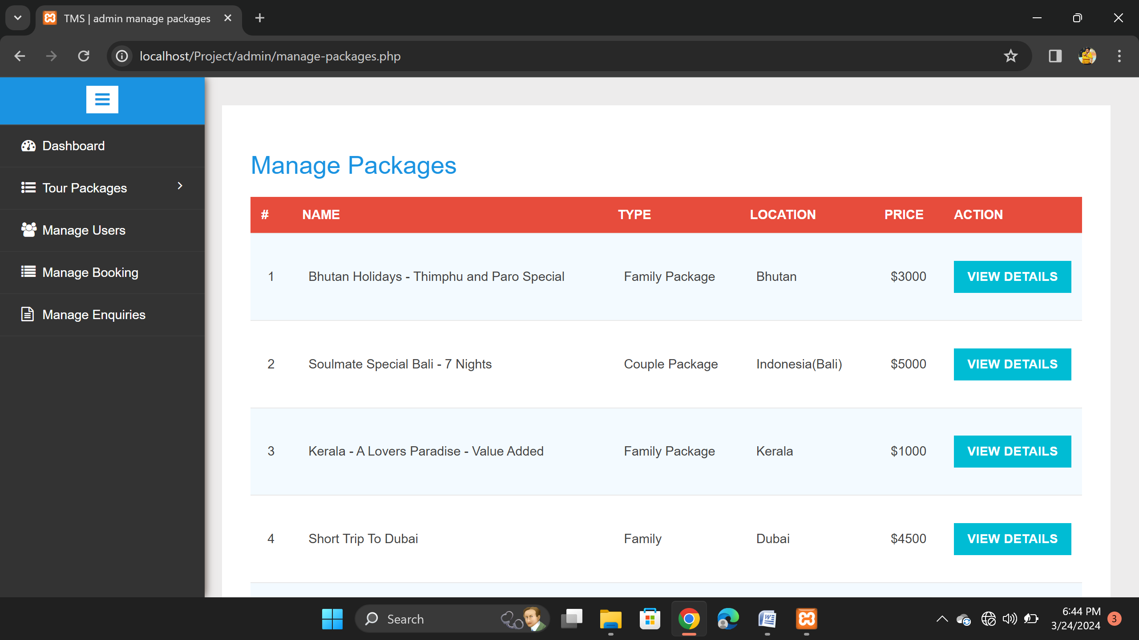
Manage Package

Slide 64
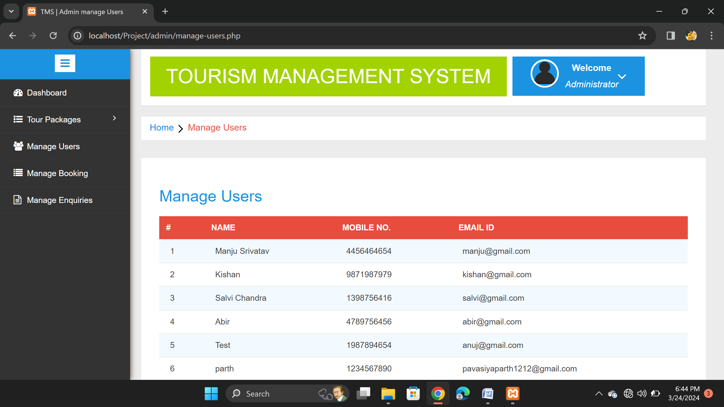
Manage User

Slide 65
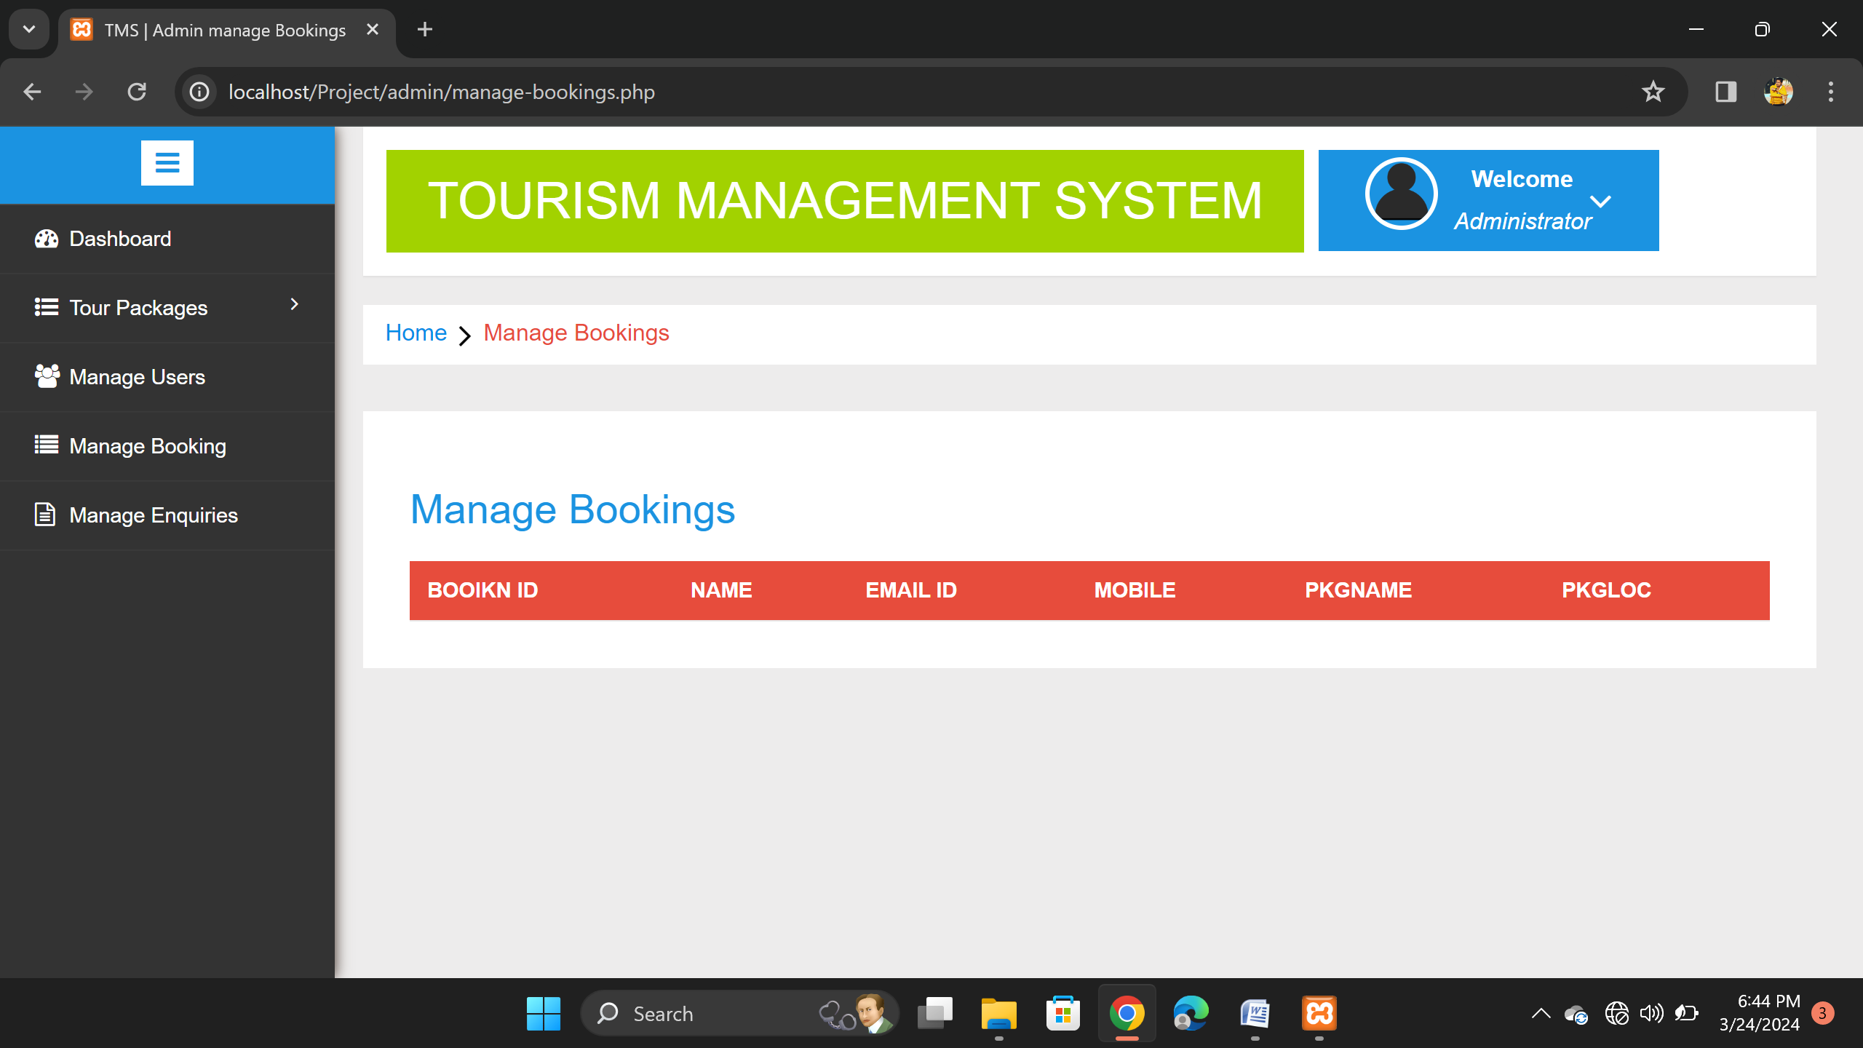
Manage Booking

Slide 66
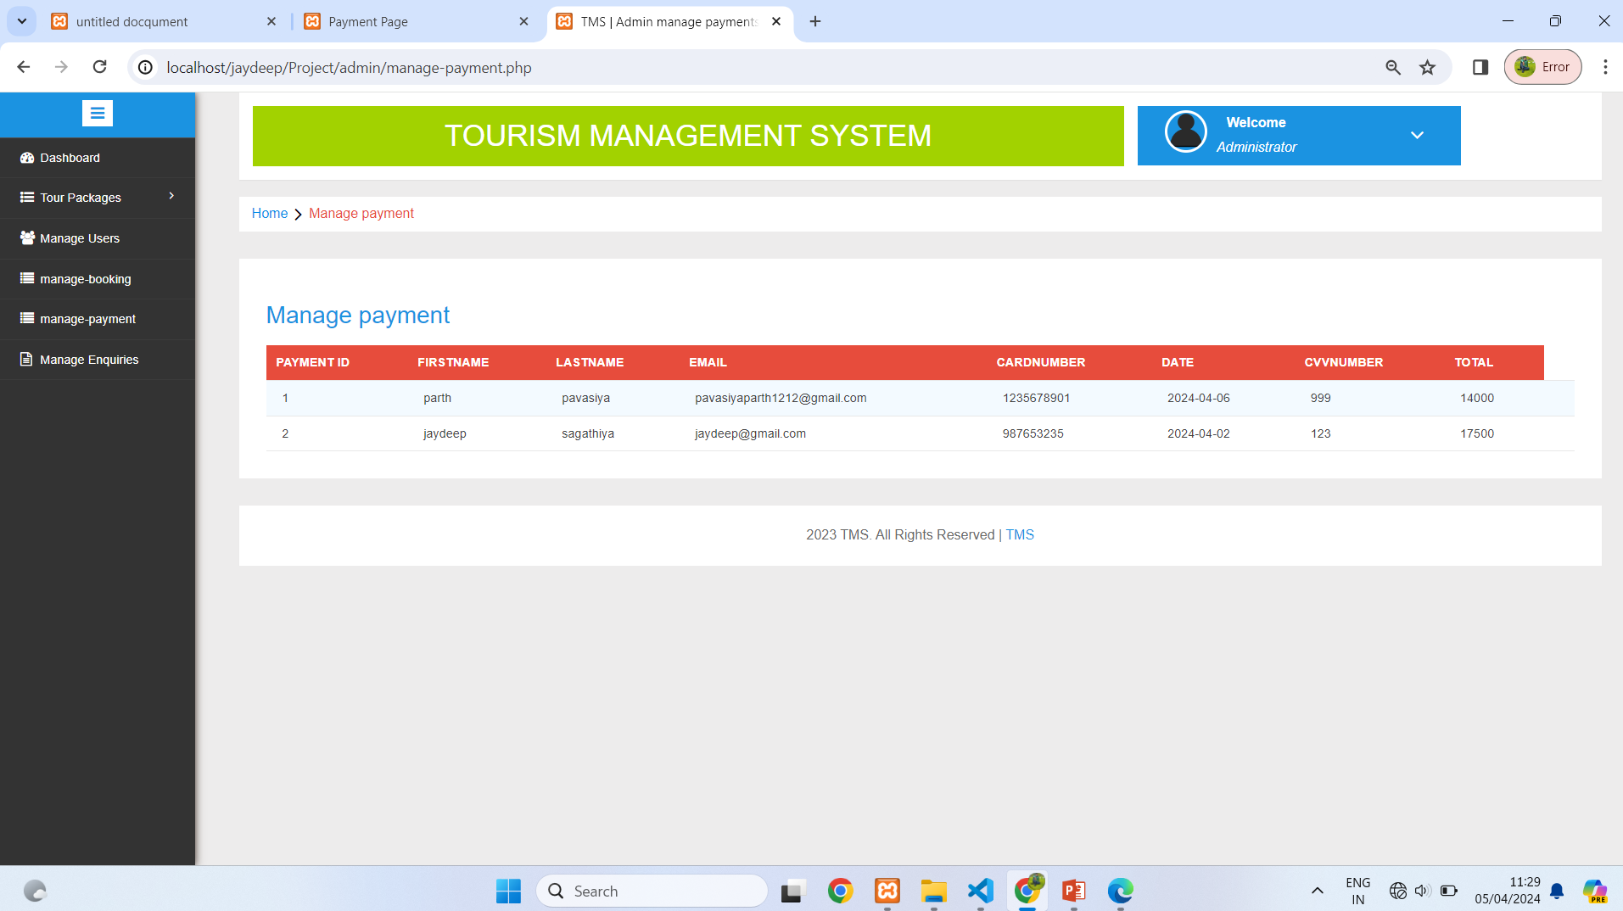
Manage Payment

Slide 67
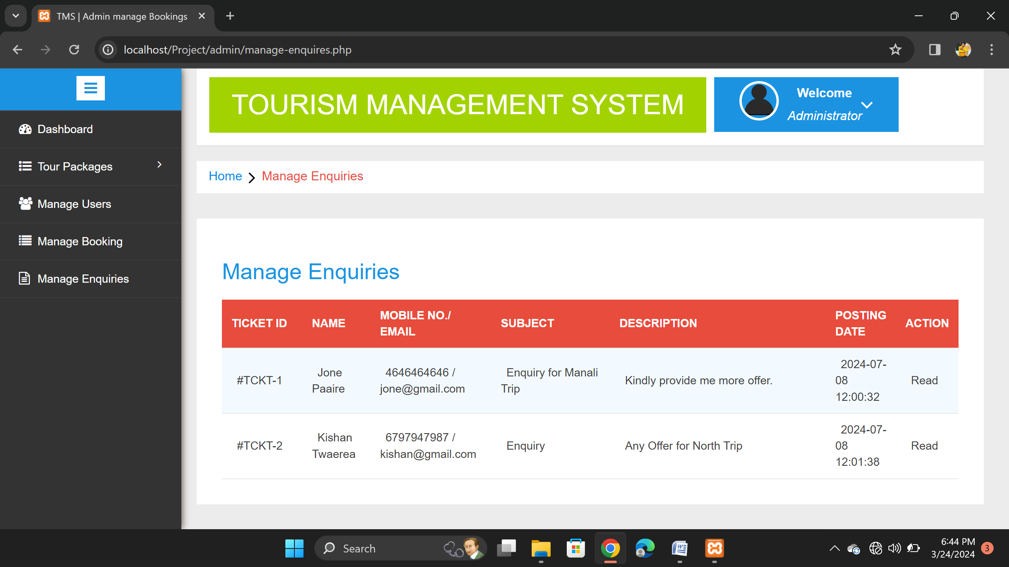
Manage Enquiry

Slide 68
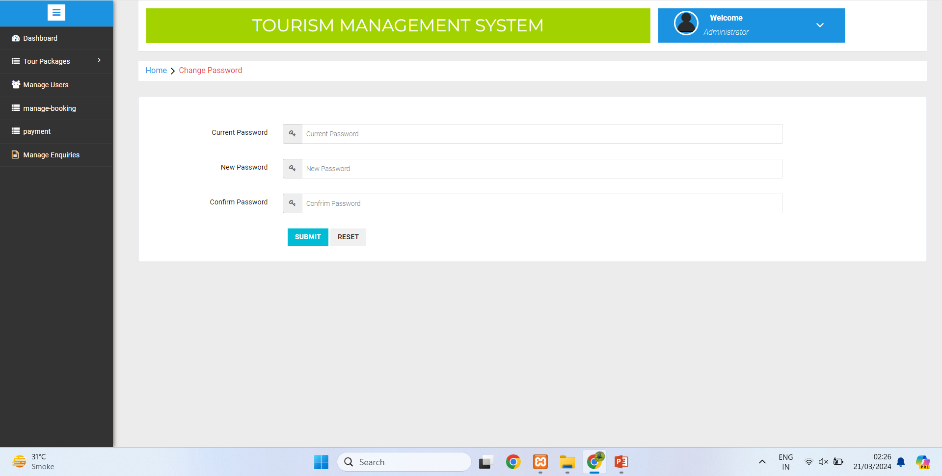
Change Password

Slide 69

CHAPTER 4
Testing and Implementations

Slide 70
4.1 Testing Approach Used
The phases of system development life cycle tests system design.
Testing of system decides whether the newly designed system works properly or not. After the development of documentation manually about the system this stage is checked.
And if the system working properly then it will be considered for implementation and if isn’t then it will be considered for implementation and if isn’t then system analyst is informed to find out generated errors or problems and to find out its solutions.
This process is known as debugging. For any software system testing means to check out it’s coding.
If there is not any problem in the coding then that code is proper and efficient to design.
Especially, database errors annoyed us but at last we solved it, successfully. Some of the errors are listed below with their cause and solution.

Slide 71
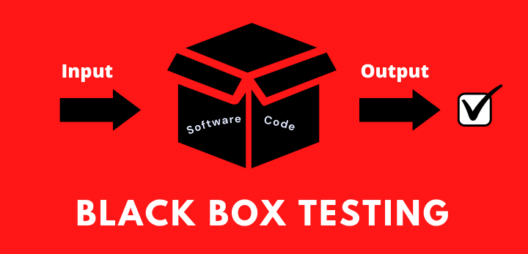
1) Black-box Testing
Interface errors
Errors I fetching external date
Behaviour or performance errors
Incorrect or missing function
Initialization and termination error

Slide 72

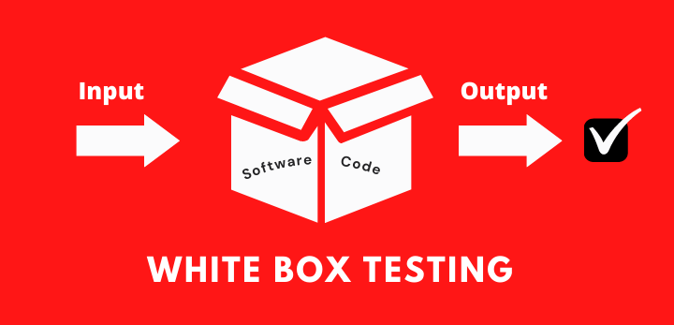
2) WHITE-box Testing
Control flow testing
Data flow testing
Branch testing
Statement coverage
Decision coverage
Modified condition/decision coverage
Path testing

Slide 73
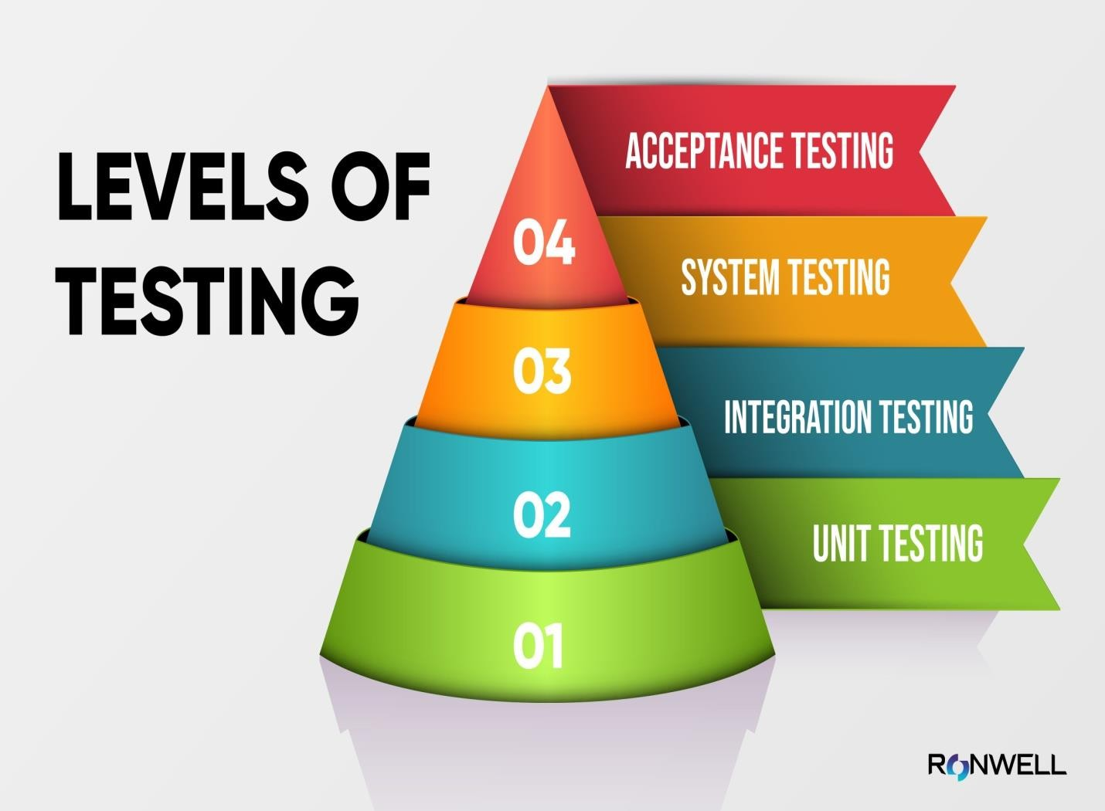
Testing Level
1 ) Unit Testing
2) Integration Testing
3) System Testing
4) Acceptance Testing

Slide 74
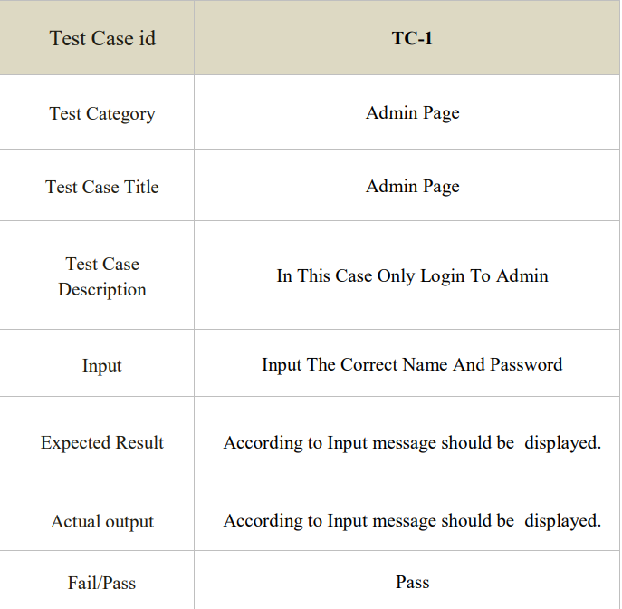
Test Case - 01

Slide 75
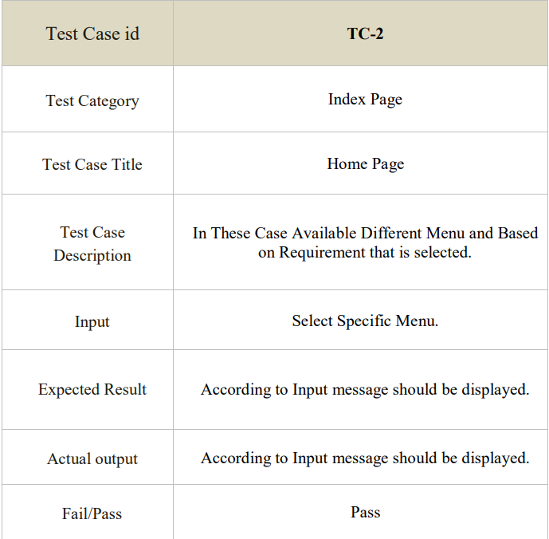
Test Case - 02

Slide 76
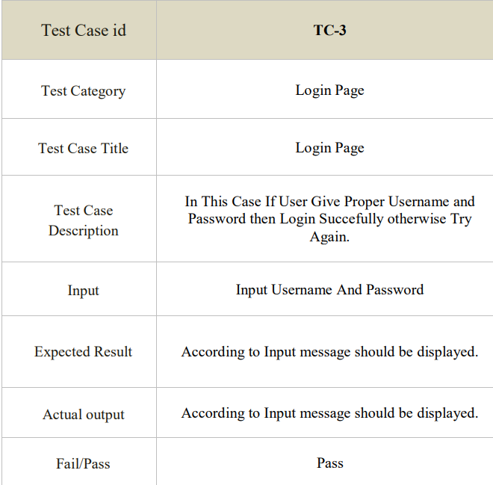
Test code - 03

Slide 77
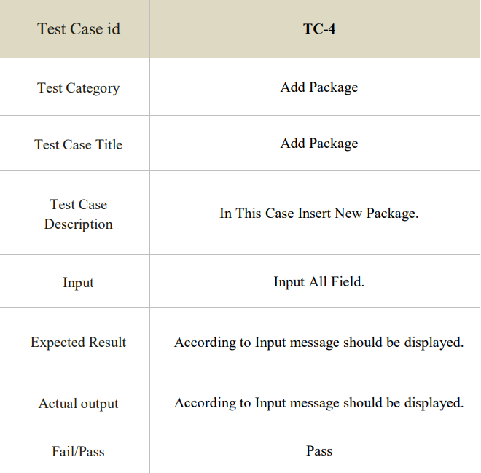
Test Case - 04

Slide 78
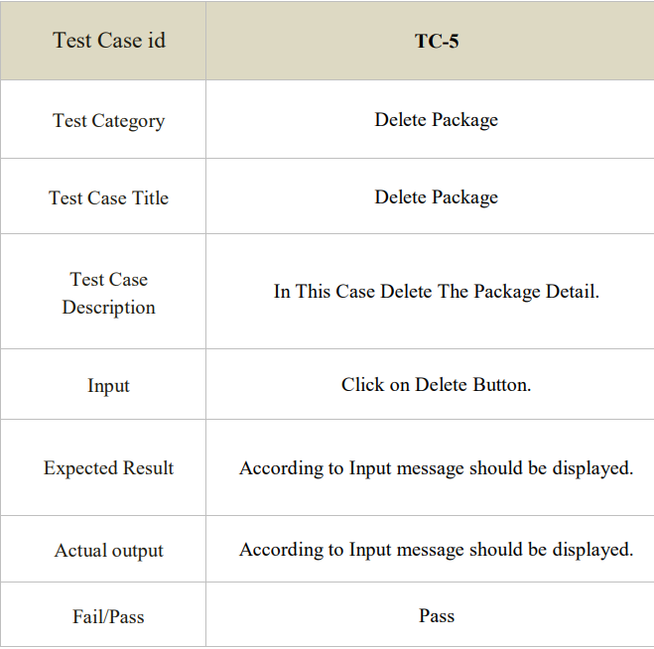
Test Case - 05

Slide 79
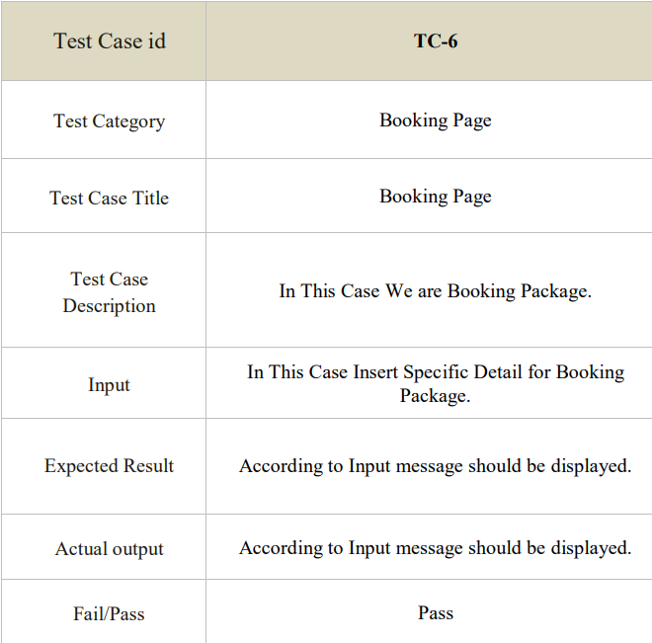
Test Case - 06

Slide 80
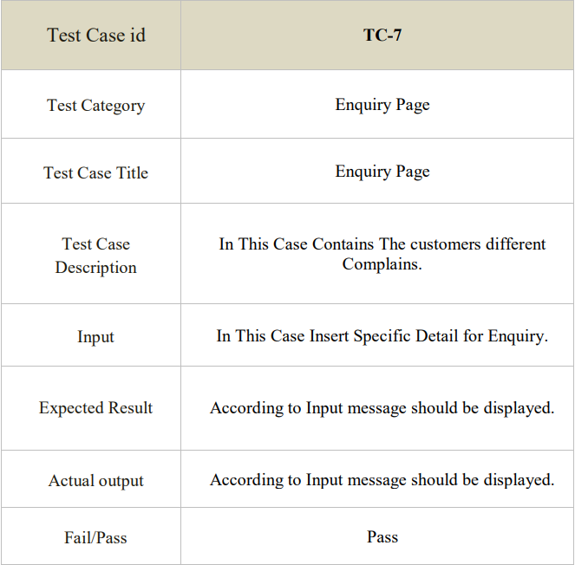
Test Case - 07

Slide 81
4.3 Implementation Approach
Application we are committed to providing our Client with a positive experience that starts with a successful implementation.
Implementation is the stage in the project where the theoretical design is turned into a working system. The implementation phase constructs, installs and operates the new system. The most stage is achieving a new successful system is that it will work efficiently and effectively.
Security and integrity of database are very important for any software system because databases are the backbone of the system. Security need to be implanted at every level of the system so that only authorized user can access the system for updation and other significance process.

Slide 82

Chapter 05
CONCLUSION

Slide 83
5.1) conclusion
In our project work, an attempt has been made to develop Tourism Managment based web site.
We develop this project that helps the people and make them aware so that they can know any news.
To establish this website we use various methodologies.
To develop this project we have faced many problem but we hardly tried to develop this project.
Our supervisor helps us by giving his valuable opinion, decision and time.

Slide 84

5.2) Limitations of system
Implementing a tourism management system can be expensive due to the necessary software, hardware and personnel needed to keep the system running.
Online connectivity issues.
The accuracy of the data collected and analyzed by the system can be unreliable due to errors in data entry or incorrect calculations.
The system may not be compatible with other systems or software used in the business.

Slide 85

5.3) Future Scope Of System
Our Project future scope is availability of location based tour details and extraction of location based user’s detail, which is very helpful to the acceptant people. All the time the network facilities cannot use.
If Customer Have Any Issue From our service then we will Provide Video call Facility and Try to Solve their Problems.
It was very difficult to complete project within this time duration but in future if we get chance we will Reach this website all over the World.

Slide 86

5.4) Bibliography
References:
https://www.google.com/
https://www.w3school.com/
https://www.unsplash.com/
https://www.bootstrap.com/
https://www.fontawsome.com/
https://www.tourmyindia.com/

Slide 87


